Slide 1
Cramér-Rao Bound Optimization for Joint Radar-Communication Beamforming
Fan Liu; Ya-Feng Liu; Ang Li; Christos Masouros; Yonina C. Eldar

Slide 2
Table of Contents

Slide 3
Abstract Overview
Objective
  Design MIMO beamforming for joint radar sensing and multi-user communications.
Performance Metric
  Use the Cramér–Rao Bound (CRB) to evaluate target estimation accuracy.
  Consider both:
    Point target
    Extended target
Proposed Method
  Minimize radar CRB
  Subject to per-user SINR constraints
  Single-user case: closed-form optimal solution
  Multi-user case: solve via SDR / SDP
Main Result
  Proposed methods can generally achieve global optimum
  They provide significant target estimation gains over benchmark methods

Slide 4
Introduction
Problem and Core Idea
  Background
    Joint radar sensing and multi-user communication are both important in modern wireless systems.
    A common MIMO beamforming design is needed to support both functions simultaneously.
  Problem
    Design MIMO beamforming for:
      radar sensing
      multi-user communications
    The sensing performance is measured by the Cramér–Rao Bound (CRB).
    The design must satisfy a required SINR for each communication user.
  Target Scenarios
    Point target
    Extended target
  Minimize the radar CRB while guaranteeing communication QoS.

Slide 5
Introduction
Method and Contributions
  Method
    Single-user case: derive closed-form optimal beamforming solutions
    Multi-user case: reformulate the problem using semidefinite relaxation (SDR)
    Solve the relaxed problems as semidefinite programs (SDP)
  Key Theoretical Result
    For the multi-user case, the paper shows that global optimum can generally be obtained
  Main Outcome
    The proposed beamforming designs achieve significant target estimation improvement
They outperform state-of-the-art benchmark methods
  A CRB-driven DFRC beamforming framework with closed-form single-user solutions
  And globally optimal multi-user designs

Slide 6
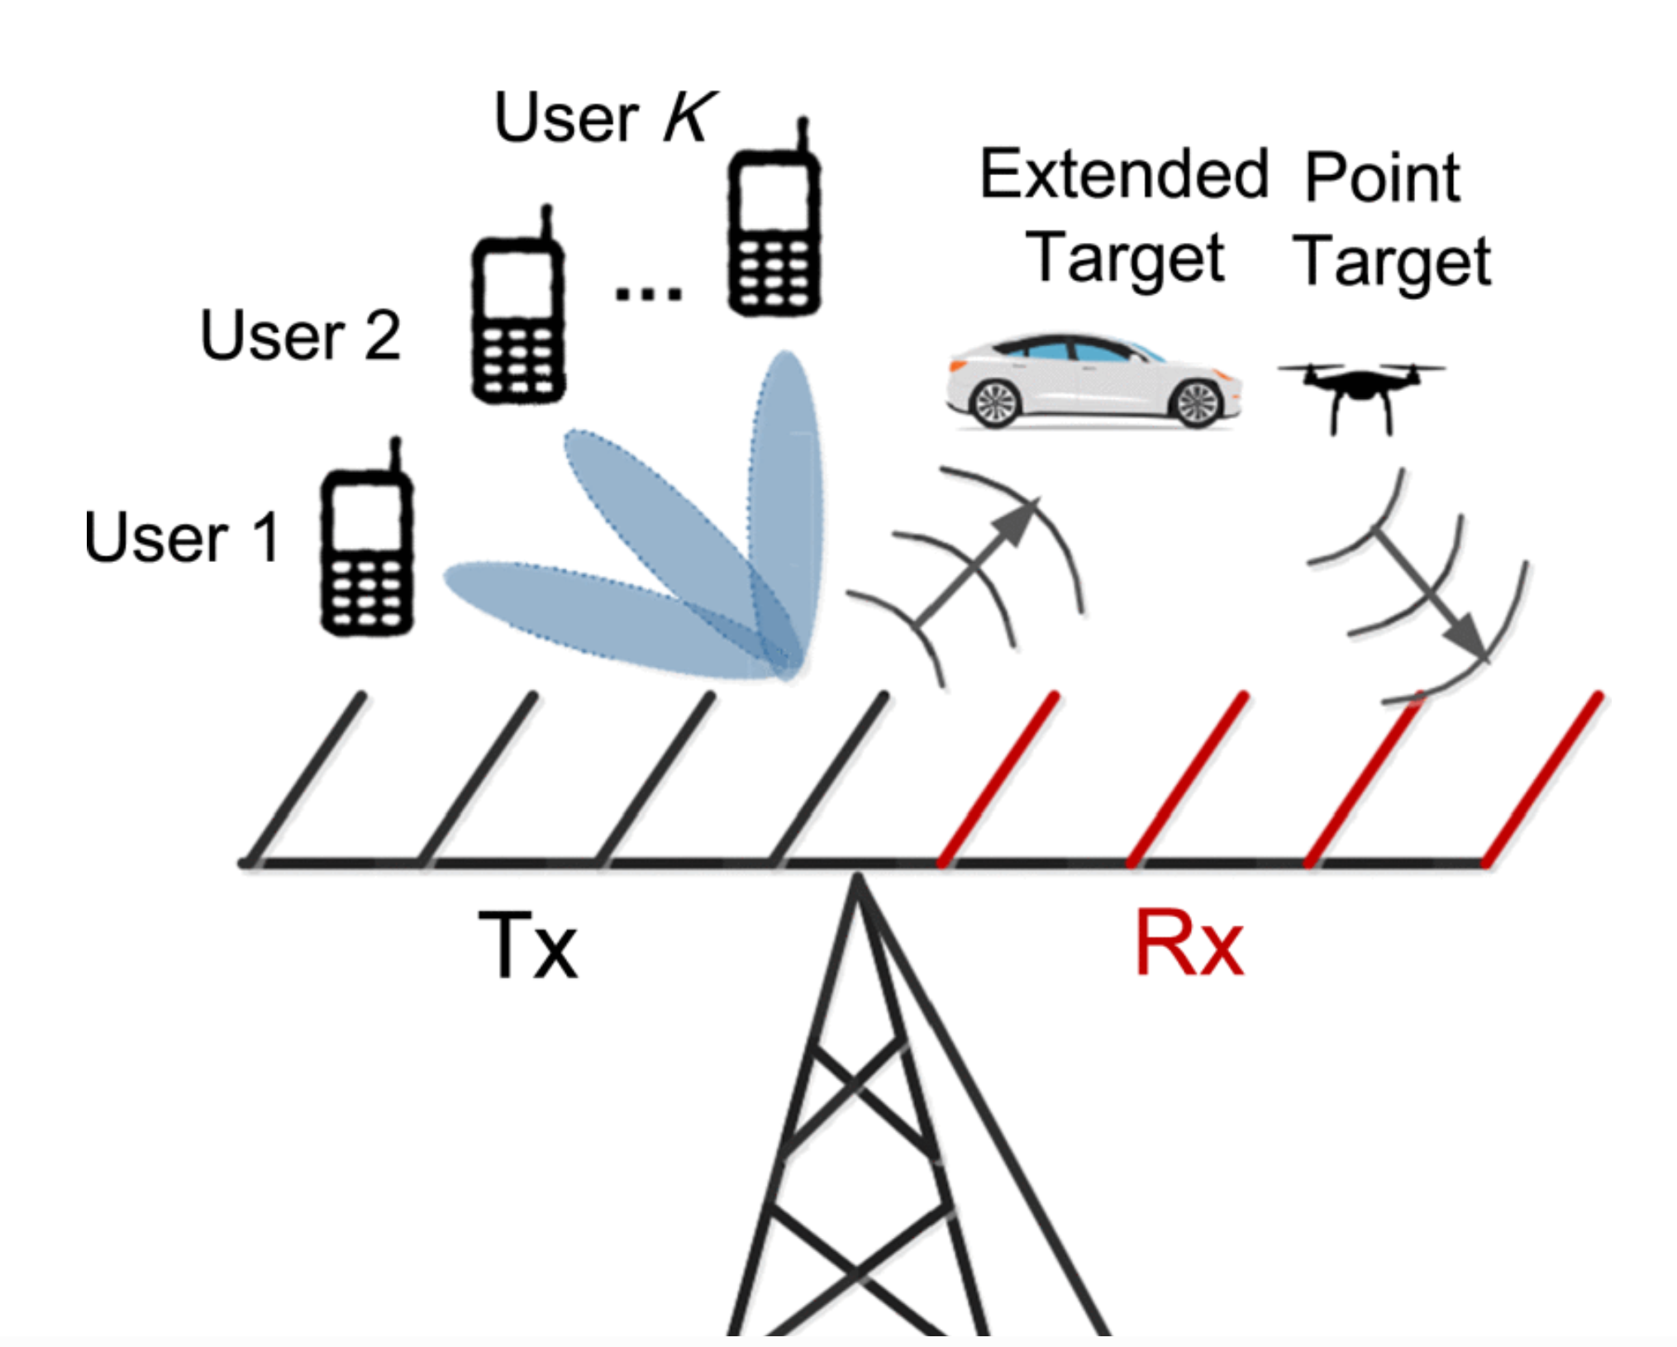

System Model
A. System Setting
  DFRC BS with $N_{t}$ transmit antennas and $N_{r}$ receive antennas
  Serves $K$ downlink single-antenna users and senses one target
  Assumption:
    $K≤N_{t}<N_{r}$
Fig. 1. Dual-functional Radar-Communication System

Slide 7

System Model
Communication and Radar Signal Models
  Transmit signal:
    $X=W_{DF}S_{C}$ (1)
  Communication received signal:
    $Y_{C}=HX+Z_{C}$ (2)
  Stream covariance:
    $\frac{1}{L}S_{C}S_{C}^{H}≈I_{K}$ (3)
  Radar echo model:
    $Y_{R}=GX+Z_{R}$ (4)

Slide 8
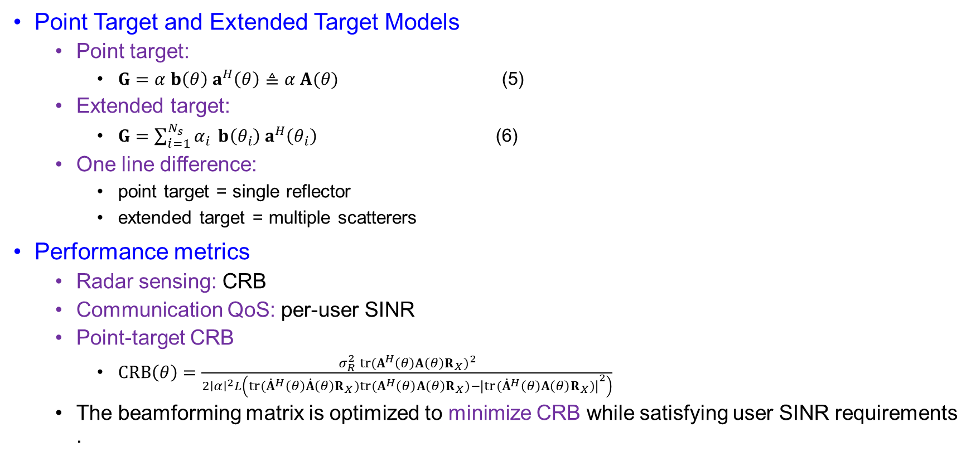
System Model
Point Target and Extended Target Models
  Point target:
    $G=α b\left(θ\right){ a}^{H}\left(θ\right)≜α A(θ)$ (5)
  Extended target:
    $G=\sum_{i=1}^{N_{s}}{α_{i} }b\left(θ_{i}\right){ a}^{H}\left(θ_{i}\right)$ (6)
  One line difference:
    point target = single reflector
    extended target = multiple scatterers
Performance metrics
  Radar sensing: CRB
  Communication QoS: per-user SINR
  Point-target CRB
    $CRB\left(θ\right)=\frac{σ_{R}^{2} tr(A^{H}\left(θ\right)A\left(θ\right)R_{X})^{2}}{2∣α∣^{2}L\left(tr({\dot{A}}^{H}\left(θ\right)\dot{A}\left(θ\right)R_{X})tr(A^{H}\left(θ\right)A\left(θ\right)R_{X})−{∣tr({\dot{A}}^{H}\left(θ\right)A\left(θ\right)R_{X})∣}^{2}\right)}$
  The beamforming matrix is optimized to minimize CRB while satisfying user SINR requirements.

Slide 9
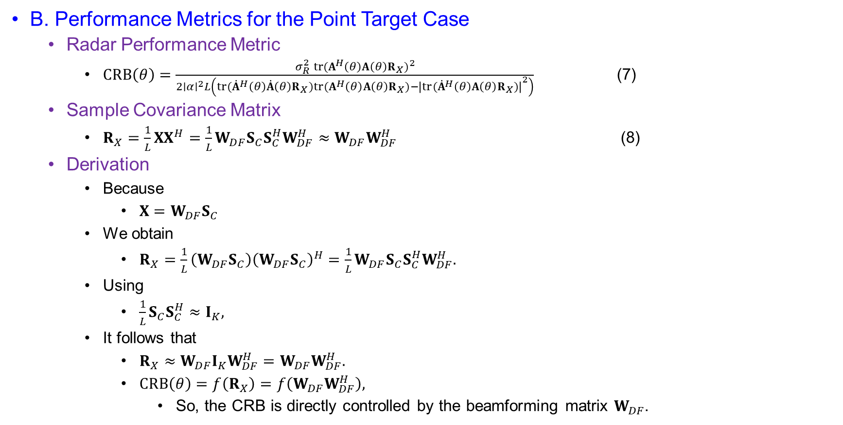
System Model
B. Performance Metrics for the Point Target Case
  Radar Performance Metric
    $CRB\left(θ\right)=\frac{σ_{R}^{2} tr(A^{H}\left(θ\right)A\left(θ\right)R_{X})^{2}}{2∣α∣^{2}L\left(tr({\dot{A}}^{H}\left(θ\right)\dot{A}\left(θ\right)R_{X})tr(A^{H}\left(θ\right)A\left(θ\right)R_{X})−{∣tr({\dot{A}}^{H}\left(θ\right)A\left(θ\right)R_{X})∣}^{2}\right)}$ (7)
  Sample Covariance Matrix
    $R_{X}=\frac{1}{L}XX^{H}=\frac{1}{L}W_{DF}S_{C}S_{C}^{H}W_{DF}^{H}≈W_{DF}W_{DF}^{H}$ (8)
  Derivation
    Because
      $X=W_{DF}S_{C}$
    We obtain
      $R_{X}=\frac{1}{L}\left(W_{DF}S_{C}\right){\left(W_{DF}S_{C}\right)}^{H}=\frac{1}{L}W_{DF}S_{C}S_{C}^{H}W_{DF}^{H}.$
    Using
      $\frac{1}{L}S_{C}S_{C}^{H}≈I_{K},$
    It follows that
      $R_{X}≈W_{DF}I_{K}W_{DF}^{H}=W_{DF}W_{DF}^{H}.$
      $CRB\left(θ\right)=f\left(R_{X}\right)=f\left(W_{DF}W_{DF}^{H}\right),$
        So, the CRB is directly controlled by the beamforming matrix $W_{DF}$.

Slide 10
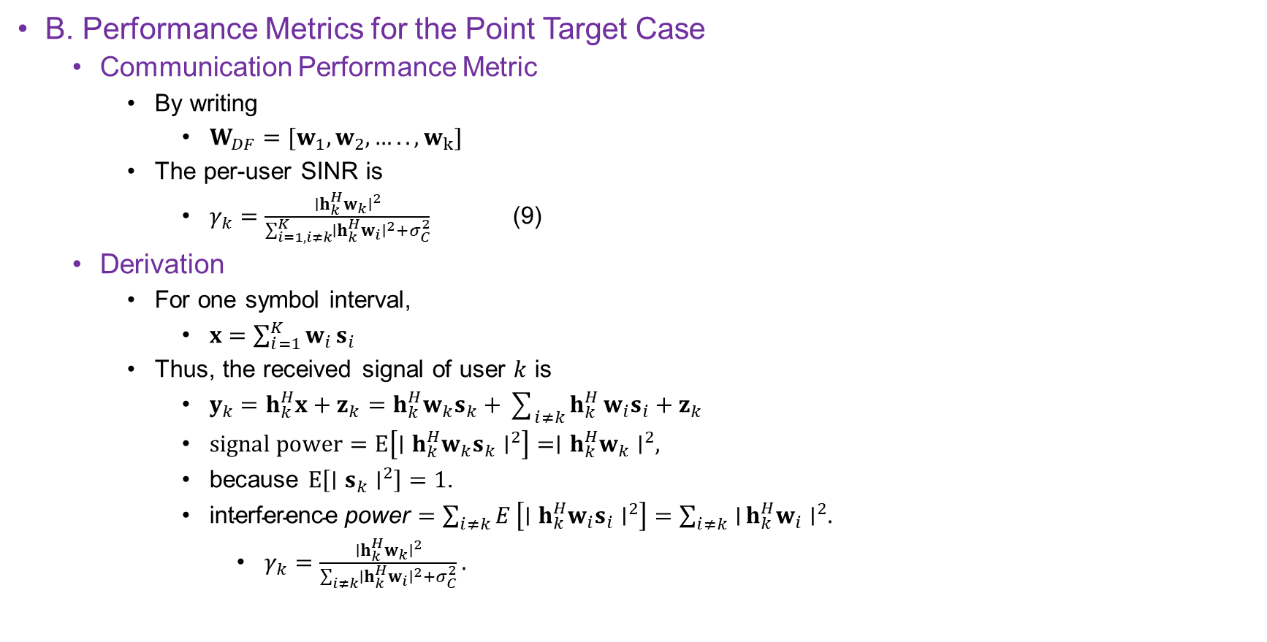
System Model
B. Performance Metrics for the Point Target Case
  Communication Performance Metric
    By writing
      $W_{DF}=[w_{1}, w_{2}, ….., w_{k}]$
    The per-user SINR is
      $γ_{k}=\frac{∣h_{k}^{H}w_{k}∣^{2}}{\sum_{i=1,i≠k}^{K}{∣}h_{k}^{H}w_{i}∣^{2}+σ_{C}^{2}}$ (9)
  Derivation
    For one symbol interval,
      $x=\sum_{i=1}^{K}{w_{i}}s_{i}$
    Thus, the received signal of user $k$ is
      $y_{k}=h_{k}^{H}x+z_{k}=h_{k}^{H}w_{k}s_{k}+\sum_{i≠k}{h_{k}^{H}}w_{i}s_{i}+z_{k}$
      $signal power=E\left[∣h_{k}^{H}w_{k}s_{k}∣^{2}\right]=∣h_{k}^{H}w_{k}∣^{2},$
      because $E\left[∣s_{k}∣^{2}\right]=1$.
      $\text{interference} \text{power}=\sum_{i≠k}{E}\left[∣h_{k}^{H}w_{i}s_{i}∣^{2}\right]=\sum_{i≠k}{∣}h_{k}^{H}w_{i}∣^{2}.$
        $γ_{k}=\frac{∣h_{k}^{H}w_{k}∣^{2}}{\sum_{i≠k}{∣}h_{k}^{H}w_{i}∣^{2}+σ_{C}^{2}}.$

Slide 11
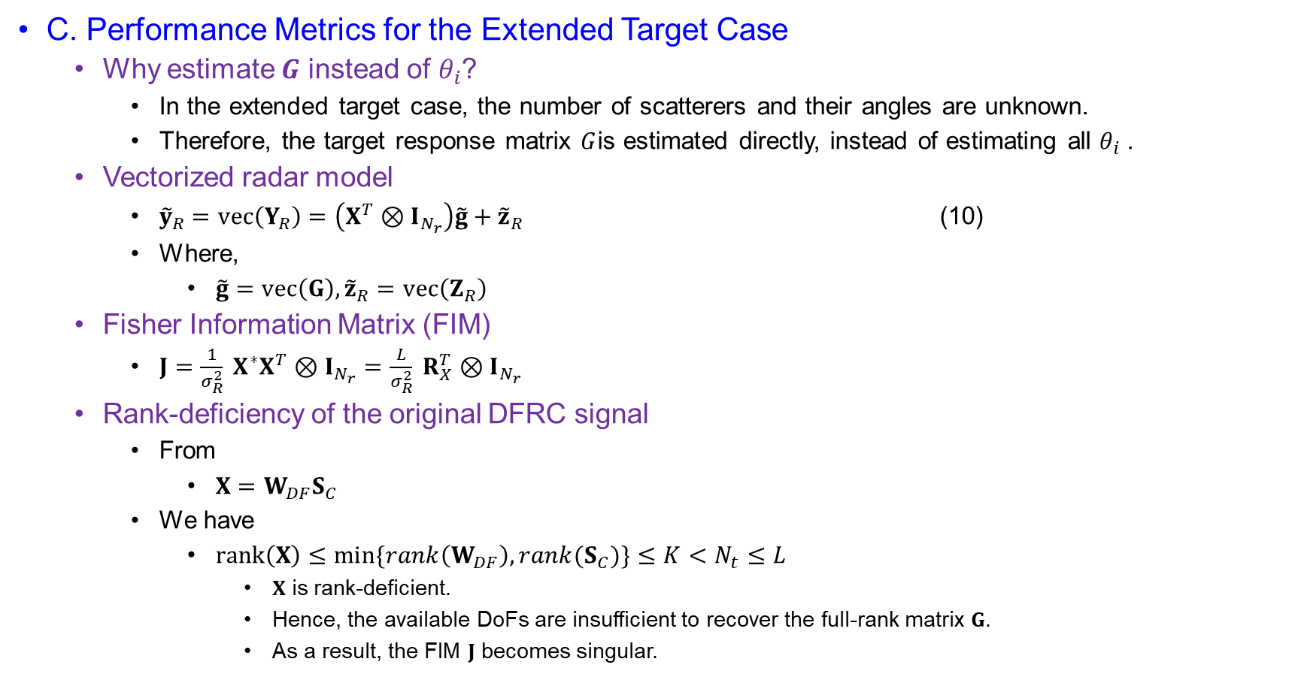
System Model
C. Performance Metrics for the Extended Target Case
  Why estimate $G$ instead of $θ_{i}$?
    In the extended target case, the number of scatterers and their angles are unknown.
    Therefore, the target response matrix $G$is estimated directly, instead of estimating all $θ_{i}$.
  Vectorized radar model
    ${\tilde{y}}_{R}=vec⁡\left(Y_{R}\right)=\left(X^{T}⊗I_{N_{r}}\right)\tilde{g}+{\tilde{z}}_{R}$ (10)
    Where,
      $\tilde{g}=vec⁡\left(G\right), {\tilde{z}}_{R}=vec⁡\left(Z_{R}\right)$
  Fisher Information Matrix (FIM)
    $J=\frac{1}{σ_{R}^{2}} X^{∗}X^{T}⊗I_{N_{r}}=\frac{L}{σ_{R}^{2}} R_{X}^{T}⊗I_{N_{r}}$
  Rank-deficiency of the original DFRC signal
    From
      $X=W_{DF}S_{C}$
    We have
      $rank⁡\left(X\right)≤\min{\{rank\left(W_{DF}\right), rank(S_{C})\}}≤K<N_{t}≤L$
        $X$ is rank-deficient.
        Hence, the available DoFs are insufficient to recover the full-rank matrix $G$.
        As a result, the FIM $J$ becomes singular.

Slide 12

System Model
Short derivation block
  Derivation of (10)
    Starting from
      $Y_{R}=GX+Z_{R}$
    apply $vec⁡\left(⋅\right)$:
      $vec⁡\left(Y_{R}\right)=vec⁡\left(GX\right)+vec⁡\left(Z_{R}\right)$
    Using
      $vec⁡\left(ABC\right)=\left(C^{T}⊗A\right)vec⁡\left(B\right)$
    with $A=I_{N_{r}}$, $B=G$, $C=X$, we get
      ${\tilde{y}}_{R}=\left(X^{T}⊗I_{N_{r}}\right)\tilde{g}+{\tilde{z}}_{R}$

Slide 13
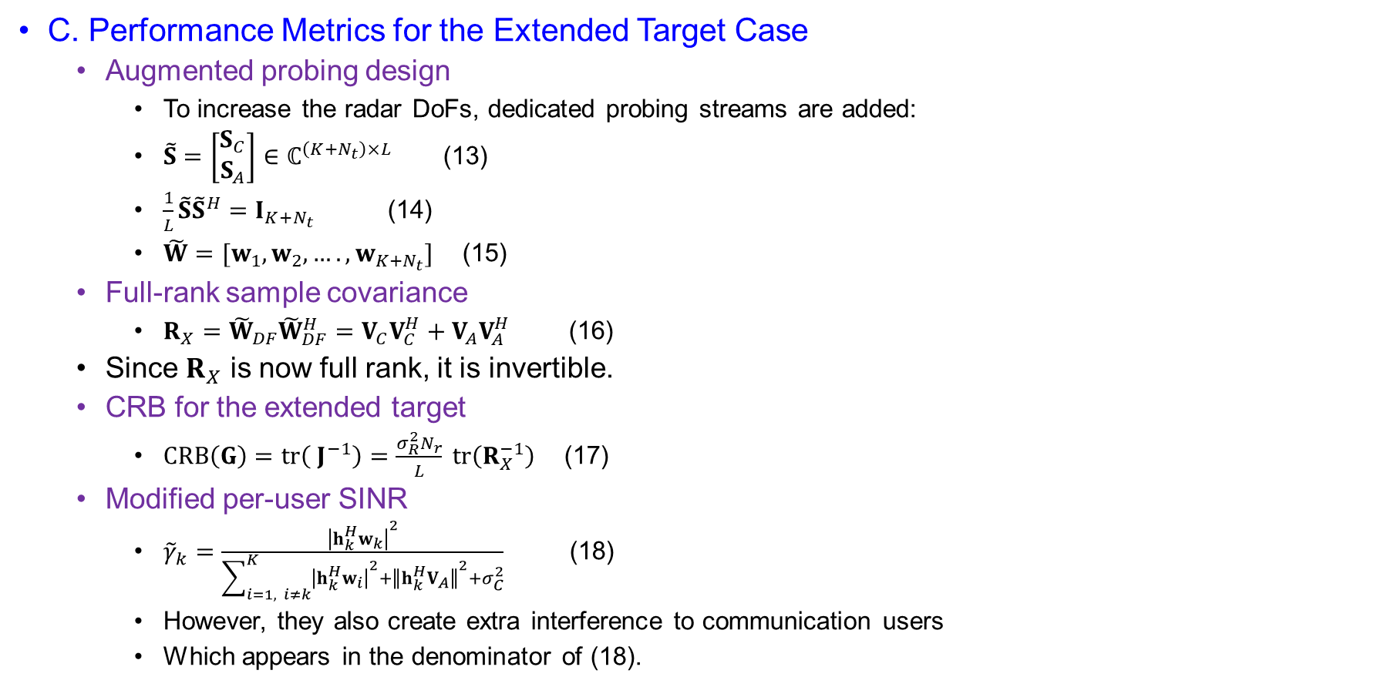
System model
C. Performance Metrics for the Extended Target Case
  Augmented probing design
    To increase the radar DoFs, dedicated probing streams are added:
    $\tilde{S}=\left[\begin{matrix}S_{C} \\ S_{A}\end{matrix}\right]∈ℂ^{\left(K+N_{t}\right)×L}$ (13)
    $\frac{1}{L}\tilde{S}{\tilde{S}}^{H}=I_{K+N_{t}}$ (14)
    $\tilde{W}=[w_{1}, w_{2}, …., w_{K+N_{t}}]$ (15)
  Full-rank sample covariance
    $R_{X}={\tilde{W}}_{DF}{\tilde{W}}_{DF}^{H}=V_{C}V_{C}^{H}+V_{A}V_{A}^{H}$ (16)
  Since $R_{X}$ is now full rank, it is invertible.
  CRB for the extended target
    $CRB⁡\left(G\right)=tr⁡\left( J^{−1}\right)=\frac{σ_{R}^{2}N_{r}}{L} tr⁡\left(R_{X}^{−1}\right)$ (17)
  Modified per-user SINR
    ${\tilde{γ}}_{k}=\frac{{∣h_{k}^{H}w_{k}∣}^{2}}{\sum_{i=1, i≠k}^{K}{{∣h_{k}^{H}w_{i}∣}^{2}}+{∥h_{k}^{H}V_{A}∥}^{2}+σ_{C}^{2}}$ (18)
    However, they also create extra interference to communication users
    Which appears in the denominator of (18).

Slide 14

System Model
Derivation
  Derivation of (16)
    $X={\tilde{W}}_{DF}\tilde{S}$
    $R_{X}=\frac{1}{L}XX^{H}=\frac{1}{L}{\tilde{W}}_{DF}\tilde{S}{\tilde{S}}^{H}{\tilde{W}}_{DF}^{H}$
    $\frac{1}{L}\tilde{S}{\tilde{S}}^{H}=I_{K+N_{t}},$
    $R_{X}={\tilde{W}}_{DF}{\tilde{W}}_{DF}^{H}=V_{C}V_{C}^{H}+V_{A}V_{A}^{H}$
  Derivation of (17)
    $J=\frac{L}{σ_{R}^{2}}R_{X}^{T}⊗I_{N_{r}}$
    $J^{−1}=\frac{σ_{R}^{2}}{L}{\left(R_{X}^{−1}\right)}^{T}⊗I_{N_{r}}$
    $tr⁡\left(J^{−1}\right)=\frac{σ_{R}^{2}}{L}\operatorname{tr}{ }\left({\left(R_{X}^{−1}\right)}^{T}⊗I_{N_{r}}\right)$
    $tr⁡\left(A⊗B\right)=tr⁡\left(A\right)tr⁡\left(B\right)$
    $CRB⁡\left(G\right)=\frac{σ_{R}^{2}N_{r}}{L}tr⁡\left(R_{X}^{−1}\right)$

Slide 15
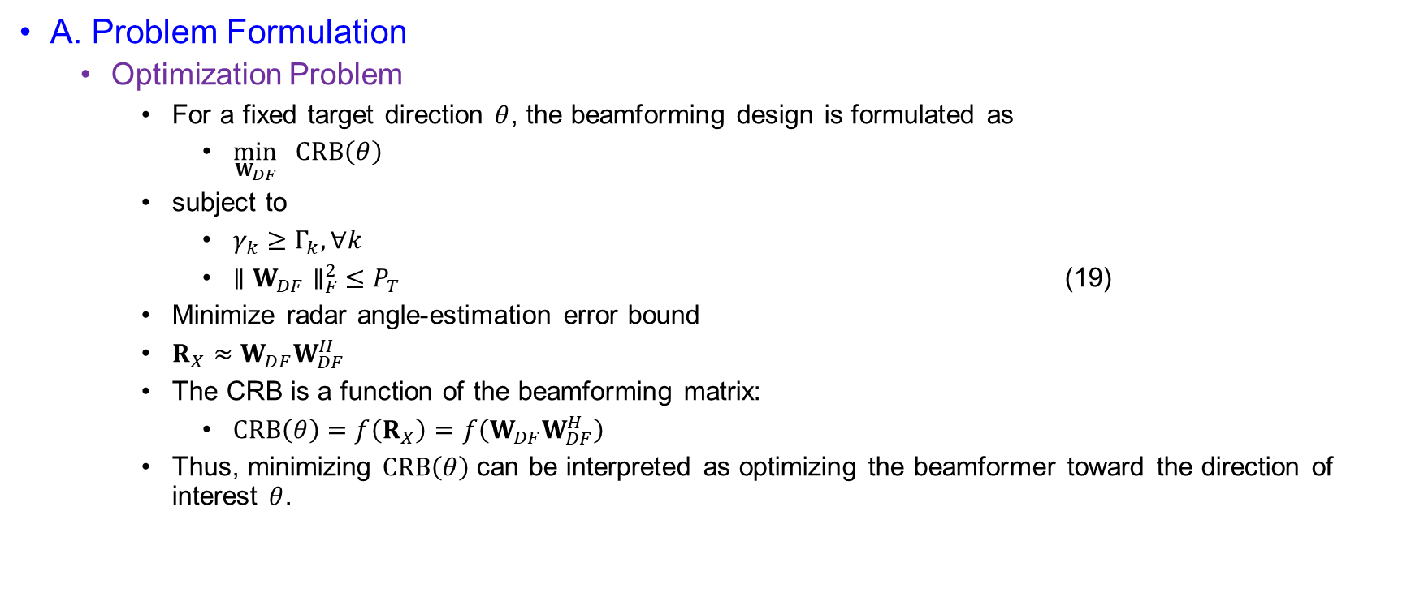
Joint Beamforming Design for Point Target
A. Problem Formulation
  Optimization Problem
    For a fixed target direction $θ$, the beamforming design is formulated as
      $\min_{W_{DF}} CRB\left(θ\right)$
    subject to
      $γ_{k}≥Γ_{k}, ∀k$
      $∥W_{DF}∥_{F}^{2} ≤P_{T}$ (19)
    Minimize radar angle-estimation error bound
    $R_{X}≈W_{DF}W_{DF}^{H}$
    The CRB is a function of the beamforming matrix:
      $CRB\left(θ\right)=f\left(R_{X}\right)=f\left(W_{DF}W_{DF}^{H}\right)$
    Thus, minimizing $CRB\left(θ\right)$ can be interpreted as optimizing the beamformer toward the direction of interest $θ$.

Slide 16
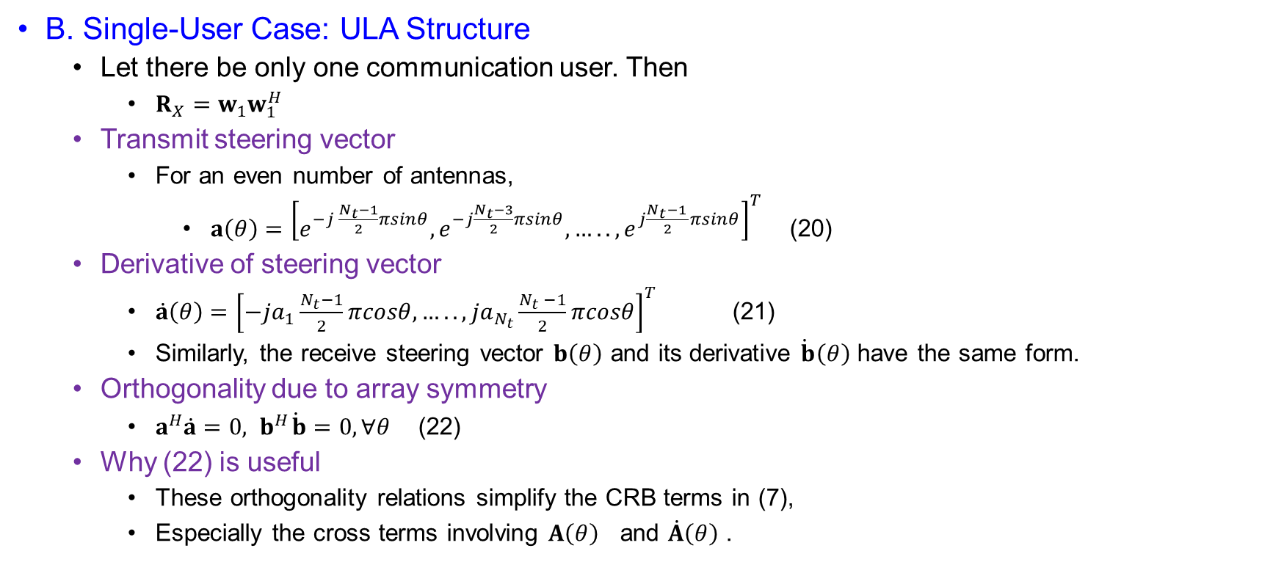
Joint Beamforming Design for Point Target
B. Single-User Case: ULA Structure
  Let there be only one communication user. Then
    $R_{X}=w_{1}w_{1}^{H}$
  Transmit steering vector
    For an even number of antennas,
      $a\left(θ\right)={\left[e^{−j \frac{N_{t}−1}{2}πsinθ}, e^{−j\frac{N_{t}−3}{2}πsinθ}, ….., e^{j\frac{N_{t}−1 }{2}πsinθ}\right]}^{T}$ (20)
  Derivative of steering vector
    $\dot{a}\left(θ\right)={\left[−ja_{1}\frac{N_{t}−1}{2}πcosθ,…..,ja_{N_{t}}\frac{N_{t} −1}{2}πcosθ\right]}^{T}$ (21)
    Similarly, the receive steering vector $b\left(θ\right)$ and its derivative $\dot{b}\left(θ\right)$ have the same form.
  Orthogonality due to array symmetry
    $a^{H}\dot{a}=0, { b}^{H}\dot{b}=0, ∀θ$ (22)
  Why (22) is useful
    These orthogonality relations simplify the CRB terms in (7),
    Especially the cross terms involving $A\left(θ\right)$ and $\dot{A}\left(θ\right)$.

Slide 17
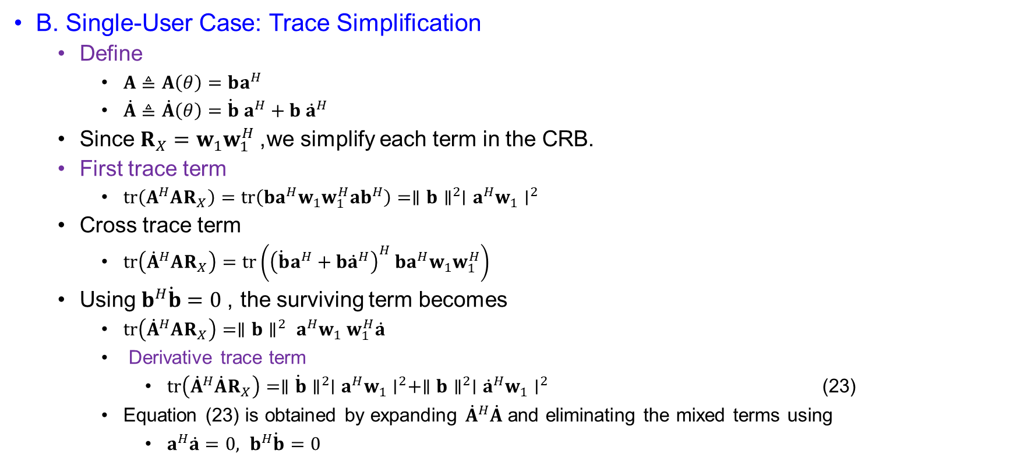
Joint Beamforming Design for Point Target
B. Single-User Case: Trace Simplification
  Define
    $A≜A\left(θ\right)=ba^{H}$
    $\dot{A}≜\dot{A}\left(θ\right)=\dot{b} a^{H}+b {\dot{a}}^{H}$
  Since $R_{X}=w_{1}w_{1}^{H}$, we simplify each term in the CRB.
  First trace term
    $tr⁡\left(A^{H}AR_{X}\right)=tr⁡\left(ba^{H}w_{1}w_{1}^{H}ab^{H}\right)=∥b∥^{2}∣a^{H}w_{1}∣^{2}$
  Cross trace term
    $tr⁡\left({\dot{A}}^{H}AR_{X}\right)=tr\left({\left(\dot{b}a^{H}+b{\dot{a}}^{H}\right)}^{H} ba^{H}w_{1}w_{1}^{H}\right)$
  Using $b^{H}\dot{b}=0$, the surviving term becomes
    $tr⁡\left({\dot{A}}^{H}AR_{X}\right)=∥b∥^{2} a^{H}w_{1} w_{1}^{H}\dot{a}$
    Derivative trace term
      $tr⁡\left({\dot{A}}^{H}\dot{A}R_{X}\right)=∥\dot{b}∥^{2}∣a^{H}w_{1}∣^{2}+∥b∥^{2}∣{\dot{a}}^{H}w_{1}∣^{2}$ (23)
    Equation (23) is obtained by expanding ${\dot{A}}^{H}\dot{A}$ and eliminating the mixed terms using
      $a^{H}\dot{a}=0, b^{H}\dot{b}=0$

Slide 18
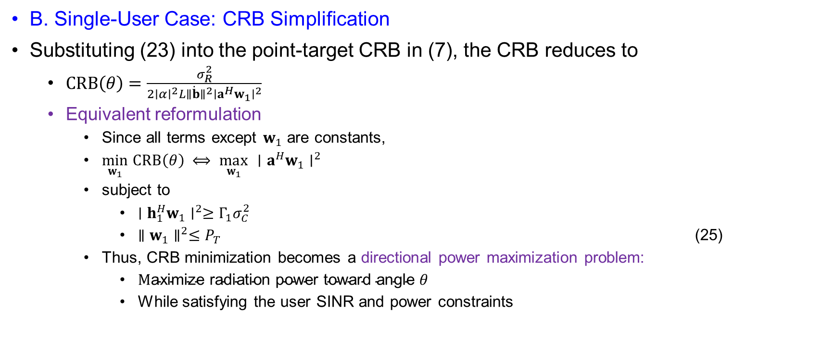
Joint Beamforming Design for Point Target
B. Single-User Case: CRB Simplification
Substituting (23) into the point-target CRB in (7), the CRB reduces to
  $CRB\left(θ\right)=\frac{σ_{R}^{2}}{2∣α∣^{2}L∥\dot{b}∥^{2}∣a^{H}w_{1}∣^{2}}$
  Equivalent reformulation
    Since all terms except $w_{1}$ are constants,
    $\min_{w_{1}} CRB\left(θ\right) ⟺ \max_{w_{1}} ∣a^{H}w_{1}∣^{2}$
    subject to
      $∣h_{1}^{H}w_{1}∣^{2}≥Γ_{1}σ_{C}^{2}$
      $∥w_{1}∥^{2}≤P_{T}$ (25)
    Thus, CRB minimization becomes a directional power maximization problem:
      $\text{M}\text{aximize} \text{radiation} \text{power} \text{toward} \text{angle} θ$
      While satisfying the user SINR and power constraints

Slide 19
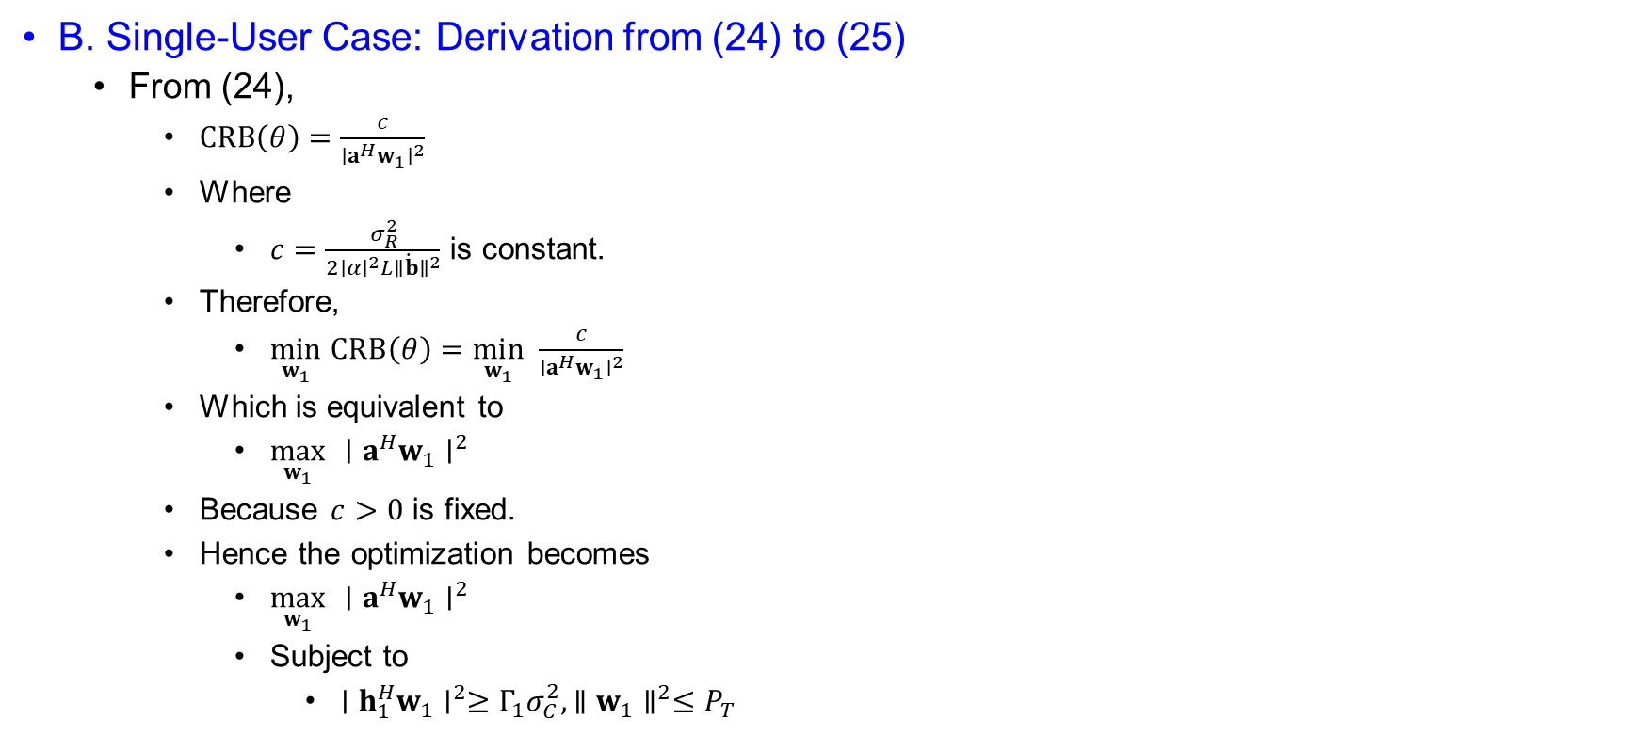
Joint Beamforming Design for Point Target
B. Single-User Case: Derivation from (24) to (25)
  From (24),
    $CRB\left(θ\right)=\frac{c}{∣a^{H}w_{1}∣^{2}}$
    Where
      $c=\frac{σ_{R}^{2}}{2∣α∣^{2}L∥\dot{b}∥^{2}}$ is constant.
    Therefore,
      $\min_{w_{1}} CRB\left(θ\right)=\min_{w_{1}} \frac{c}{∣a^{H}w_{1}∣^{2}}$
    Which is equivalent to
      $\max_{w_{1}} ∣a^{H}w_{1}∣^{2}$
    Because $c>0$ is fixed.
    Hence the optimization becomes
      $\max_{w_{1}} ∣a^{H}w_{1}∣^{2}$
      Subject to
        $∣h_{1}^{H}w_{1}∣^{2}≥Γ_{1}σ_{C}^{2}, ∥w_{1}∥^{2}≤P_{T}$

Slide 20
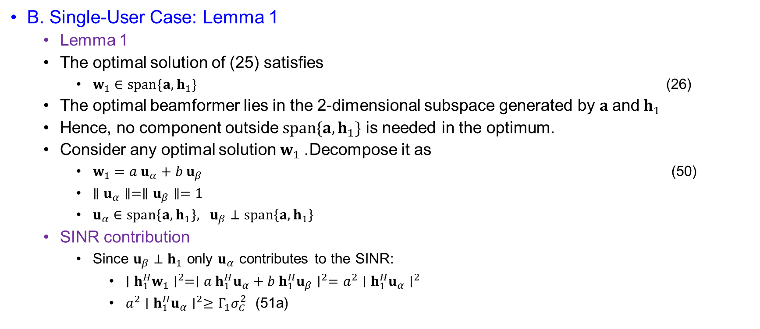
Joint Beamforming Design for Point Target
B. Single-User Case: Lemma 1
  Lemma 1
  The optimal solution of (25) satisfies
    $w_{1}∈span⁡\{a,h_{1}\}$ (26)
  The optimal beamformer lies in the 2-dimensional subspace generated by $a \text{and} h_{1}$
  Hence, no component outside $span⁡\{a,h_{1}\}$ is needed in the optimum.
  Consider any optimal solution $w_{1}$. Decompose it as
    $w_{1}=a u_{α}+b u_{β}$ (50)
    $∥u_{α}∥=∥u_{β}∥=1$
    $u_{α}∈span\left\{a, h_{1}\right\}, u_{β}⊥span\left\{a, h_{1}\right\}$
  SINR contribution
    Since $u_{β}⊥h_{1}$ only $u_{α}$ contributes to the SINR:
      $∣h_{1}^{H}w_{1}∣^{2}=∣a h_{1}^{H}u_{α}+b h_{1}^{H}u_{β}∣^{2}=a^{2}∣h_{1}^{H}u_{α}∣^{2}$
      $a^{2}∣h_{1}^{H}u_{α}∣^{2}≥Γ_{1}σ_{C}^{2}$ (51a)

Slide 21
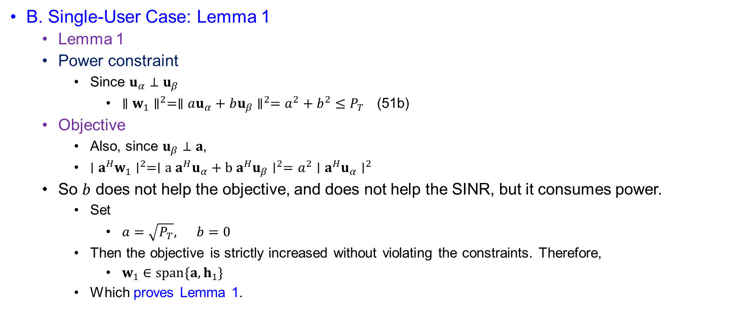
Joint Beamforming Design for Point Target
B. Single-User Case: Lemma 1
  Lemma 1
  Power constraint
    Since $u_{α}⊥u_{β}$
      $∥w_{1}∥^{2}=∥au_{α}+bu_{β}∥^{2}=a^{2}+b^{2}≤P_{T}$ (51b)
  Objective
    Also, since $u_{β}⊥a$,
    $∣a^{H}w_{1}∣^{2}=∣a a^{H}u_{α}+b a^{H}u_{β}∣^{2}=a^{2}∣a^{H}u_{α}∣^{2}$
  So $b$ does not help the objective, and does not help the SINR, but it consumes power.
    Set
      $a=\sqrt{P_{T}}, b=0$
    Then the objective is strictly increased without violating the constraints. Therefore,
      $w_{1}∈span⁡\{a,h_{1}\}$
    Which proves Lemma 1.

Slide 22
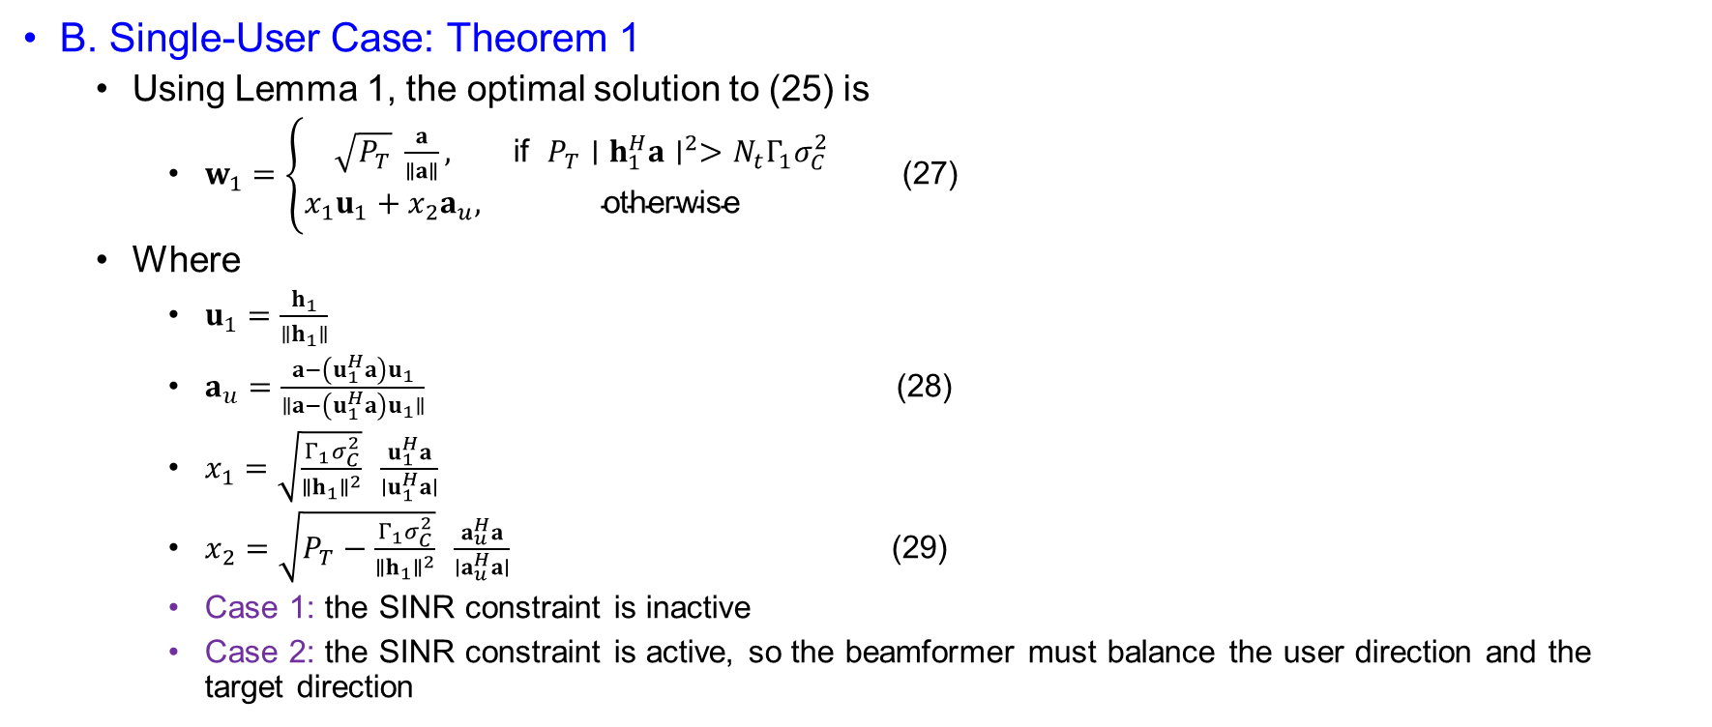
Joint Beamforming Design for Point Target
B. Single-User Case: Theorem 1
  Using Lemma 1, the optimal solution to (25) is
    $w_{1}=\left\{\begin{matrix}\sqrt{P_{T}} \frac{a}{∥a∥}, & \text{if} P_{T}∣h_{1}^{H}a∣^{2}>N_{t}Γ_{1}σ_{C}^{2} \\ x_{1}u_{1}+x_{2}a_{u}, & \text{otherwise}\end{matrix}\right.$ (27)
  Where
    $u_{1}=\frac{h_{1}}{∥h_{1}∥}$
    $a_{u}=\frac{a−\left(u_{1}^{H}a\right)u_{1}}{∥a−\left(u_{1}^{H}a\right)u_{1}∥}$ (28)
    $x_{1}=\sqrt{\frac{Γ_{1}σ_{C}^{2}}{∥h_{1}∥^{2}}} \frac{u_{1}^{H}a}{∣u_{1}^{H}a∣}$
    $x_{2}=\sqrt{P_{T}−\frac{Γ_{1}σ_{C}^{2}}{∥h_{1}∥^{2}}} \frac{a_{u}^{H}a}{∣a_{u}^{H}a∣}$ (29)
    Case 1: the SINR constraint is inactive
    Case 2: the SINR constraint is active, so the beamformer must balance the user direction and the target direction

Slide 23
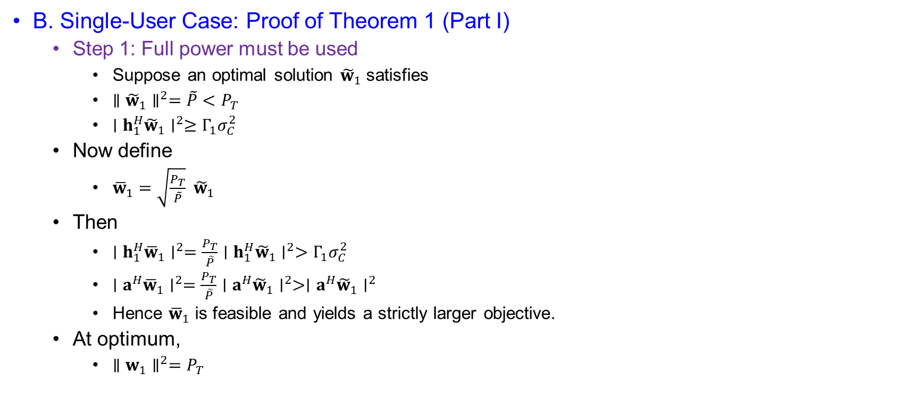
Joint Beamforming Design for Point Target
B. Single-User Case: Proof of Theorem 1 (Part I)
  Step 1: Full power must be used
    Suppose an optimal solution ${\tilde{w}}_{1}$ satisfies
    $∥{\tilde{w}}_{1}∥^{2}=\tilde{P}<P_{T}$
    $∣h_{1}^{H}{\tilde{w}}_{1}∣^{2}≥Γ_{1}σ_{C}^{2}$
  Now define
    ${\overline{w}}_{1}=\sqrt{\frac{P_{T}}{\tilde{P}}} {\tilde{w}}_{1}$
  Then
    $∣h_{1}^{H}{\overline{w}}_{1}∣^{2}=\frac{P_{T}}{\tilde{P}}∣h_{1}^{H}{\tilde{w}}_{1}∣^{2}>Γ_{1}σ_{C}^{2}$
    $∣a^{H}{\overline{w}}_{1}∣^{2}=\frac{P_{T}}{\tilde{P}}∣a^{H}{\tilde{w}}_{1}∣^{2}>∣a^{H}{\tilde{w}}_{1}∣^{2}$
    Hence ${\overline{w}}_{1}$ is feasible and yields a strictly larger objective.
  At optimum,
    $∥w_{1}∥^{2}=P_{T}$

Slide 24
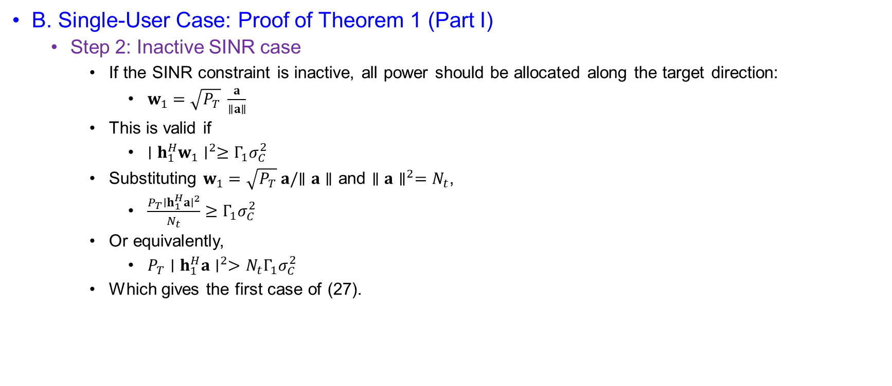
Joint Beamforming Design for Point Target
B. Single-User Case: Proof of Theorem 1 (Part I)
  Step 2: Inactive SINR case
    If the SINR constraint is inactive, all power should be allocated along the target direction:
      $w_{1}=\sqrt{P_{T}} \frac{a}{∥a∥}$
    This is valid if
      $∣h_{1}^{H}w_{1}∣^{2}≥Γ_{1}σ_{C}^{2}$
    Substituting $w_{1}=\sqrt{P_{T}} a/∥a∥$ and $∥a∥^{2}=N_{t}$,
      $\frac{P_{T}∣h_{1}^{H}a∣^{2}}{N_{t}}≥Γ_{1}σ_{C}^{2}$
    Or equivalently,
      $P_{T}∣h_{1}^{H}a∣^{2}>N_{t}Γ_{1}σ_{C}^{2}$
    Which gives the first case of (27).

Slide 25
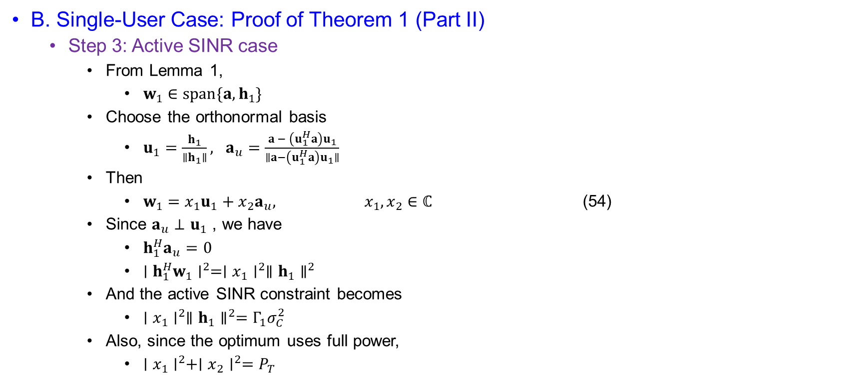
Joint Beamforming Design for Point Target
B. Single-User Case: Proof of Theorem 1 (Part II)
  Step 3: Active SINR case
    From Lemma 1,
      $w_{1}∈span\{a, h_{1}\}$
    Choose the orthonormal basis
      $u_{1}=\frac{h_{1}}{∥h_{1}∥}, a_{u}=\frac{a − \left(u_{1}^{H}a\right)u_{1}}{∥a−\left(u_{1}^{H}a\right)u_{1}∥}$
    Then
      $w_{1}=x_{1}u_{1}+x_{2}a_{u}, x_{1},x_{2}∈ℂ$ (54)
    Since $a_{u}⊥u_{1}$, we have
      $h_{1}^{H}a_{u}=0$
      $∣h_{1}^{H}w_{1}∣^{2}=∣x_{1}∣^{2}∥h_{1}∥^{2}$
    And the active SINR constraint becomes
      $∣x_{1}∣^{2}∥h_{1}∥^{2}=Γ_{1}σ_{C}^{2}$
    Also, since the optimum uses full power,
      $∣x_{1}∣^{2}+∣x_{2}∣^{2}=P_{T}$

Slide 26
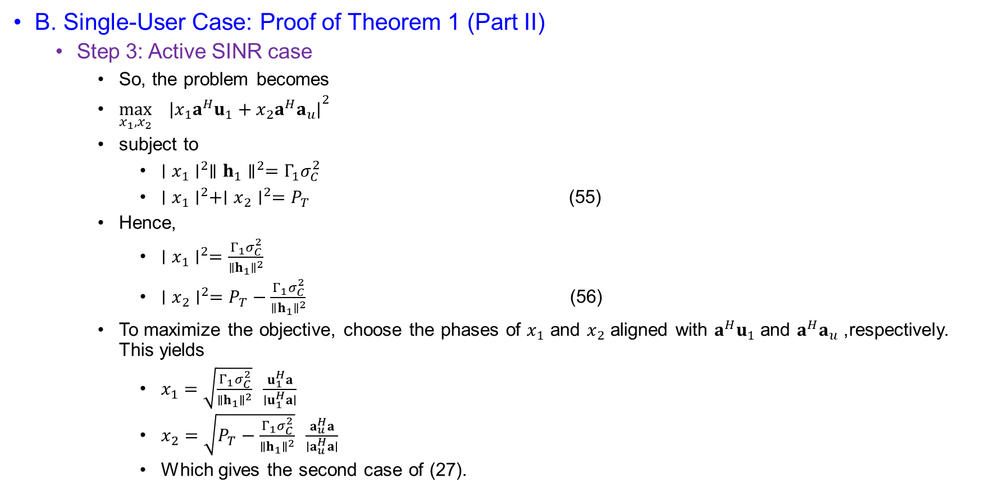
Joint Beamforming Design for Point Target
B. Single-User Case: Proof of Theorem 1 (Part II)
  Step 3: Active SINR case
    So, the problem becomes
    $\max_{x_{1},x_{2}}{ ∣x_{1}a^{H}u_{1}+x_{2}a^{H}a_{u}∣}^{2}$
    subject to
      $∣x_{1}∣^{2}∥h_{1}∥^{2}=Γ_{1}σ_{C}^{2}$
      $∣x_{1}∣^{2}+∣x_{2}∣^{2}=P_{T}$ (55)
    Hence,
      $∣x_{1}∣^{2}=\frac{Γ_{1}σ_{C}^{2}}{∥h_{1}∥^{2}}$
      $∣x_{2}∣^{2}=P_{T}−\frac{Γ_{1}σ_{C}^{2}}{∥h_{1}∥^{2}}$ (56)
    To maximize the objective, choose the phases of $x_{1}$ and $x_{2}$ aligned with $a^{H}u_{1}$ and $a^{H}a_{u}$, respectively. This yields
      $x_{1}=\sqrt{\frac{Γ_{1}σ_{C}^{2}}{∥h_{1}∥^{2}}} \frac{u_{1}^{H}a}{∣u_{1}^{H}a∣}$
      $x_{2}=\sqrt{P_{T}−\frac{Γ_{1}σ_{C}^{2}}{∥h_{1}∥^{2}}} \frac{a_{u}^{H}a}{∣a_{u}^{H}a∣}$
      Which gives the second case of (27).

Slide 27
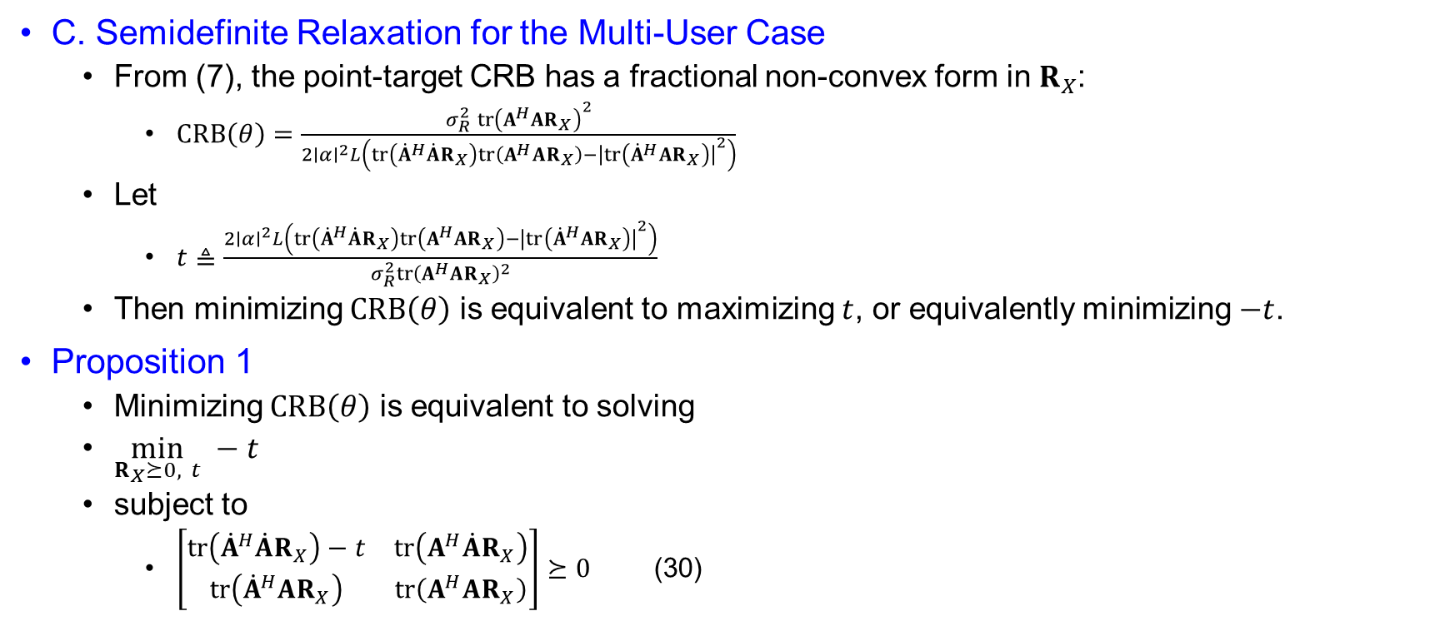
Joint Beamforming Design for Point Target
C. Semidefinite Relaxation for the Multi-User Case
  From (7), the point-target CRB has a fractional non-convex form in $R_{X}$:
    $CRB\left(θ\right)=\frac{σ_{R}^{2} tr⁡{\left(A^{H}AR_{X}\right)}^{2}}{2∣α∣^{2}L\left(\operatorname{tr}\left({\dot{A}}^{H}\dot{A}R_{X}\right)tr⁡\left(A^{H}AR_{X}\right)−{∣tr⁡\left({\dot{A}}^{H}AR_{X}\right)∣}^{2}\right)}$
  Let
    $t≜\frac{2∣α∣^{2}L\left(tr⁡\left({\dot{A}}^{H}\dot{A}R_{X}\right)tr⁡\left(A^{H}AR_{X}\right)−{∣tr⁡\left({\dot{A}}^{H}AR_{X}\right)∣}^{2}\right)}{σ_{R}^{2}tr⁡{\left(A^{H}AR_{X}\right)}^{2}}$
  Then minimizing $CRB\left(θ\right)$ is equivalent to maximizing $t$, or equivalently minimizing $−t$.
Proposition 1
  Minimizing $CRB\left(θ\right)$ is equivalent to solving
  $\min_{R_{X}⪰0, t} −t$
  subject to
    $\left[\begin{matrix}tr⁡\left({\dot{A}}^{H}\dot{A}R_{X}\right)−t & tr⁡\left(A^{H}\dot{A}R_{X}\right) \\ tr⁡\left({\dot{A}}^{H}AR_{X}\right) & tr⁡\left(A^{H}AR_{X}\right)\end{matrix}\right]⪰0$ (30)

Slide 28
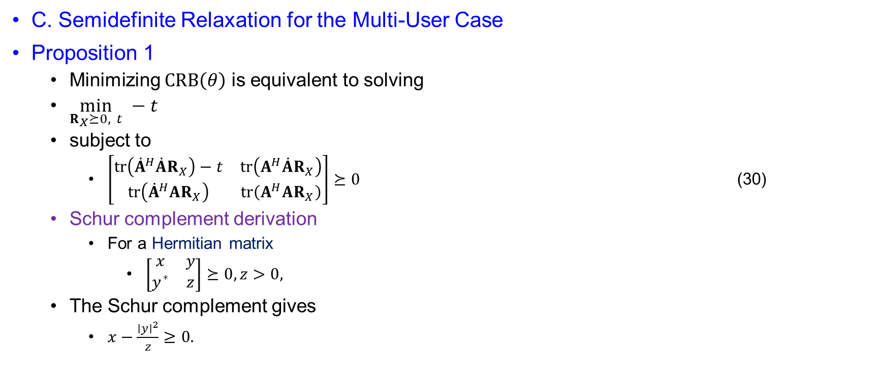
Joint Beamforming Design for Point Target
C. Semidefinite Relaxation for the Multi-User Case
Proposition 1
  Minimizing $CRB\left(θ\right)$ is equivalent to solving
  $\min_{R_{X}⪰0, t} −t$
  subject to
    $\left[\begin{matrix}tr⁡\left({\dot{A}}^{H}\dot{A}R_{X}\right)−t & tr⁡\left(A^{H}\dot{A}R_{X}\right) \\ tr⁡\left({\dot{A}}^{H}AR_{X}\right) & tr⁡\left(A^{H}AR_{X}\right)\end{matrix}\right]⪰0$ (30)
  Schur complement derivation
    For a Hermitian matrix
      $\left[\begin{matrix}x & y \\ y^{∗} & z\end{matrix}\right]⪰0, z>0,$
  The Schur complement gives
    $x−\frac{∣y∣^{2}}{z}≥0.$

Slide 29
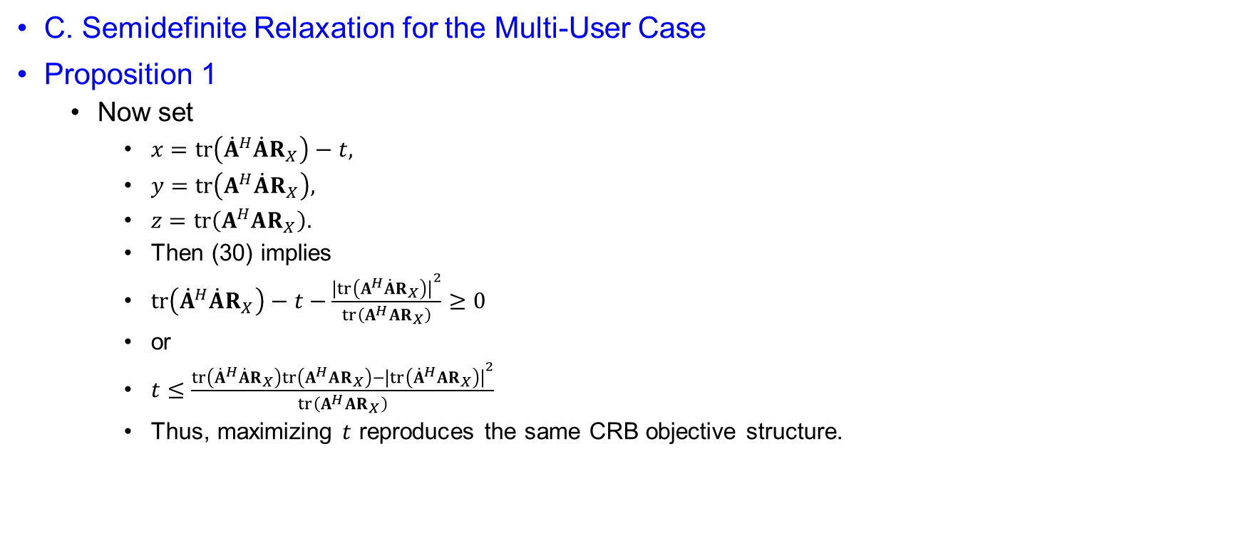
Joint Beamforming Design for Point Target
C. Semidefinite Relaxation for the Multi-User Case
Proposition 1
  Now set
    $x=tr⁡\left({\dot{A}}^{H}\dot{A}R_{X}\right)−t,$
    $y=tr⁡\left(A^{H}\dot{A}R_{X}\right),$
    $z=tr⁡\left(A^{H}AR_{X}\right).$
    Then (30) implies
    $tr⁡\left({\dot{A}}^{H}\dot{A}R_{X}\right)−t−\frac{{∣tr⁡\left(A^{H}\dot{A}R_{X}\right)∣}^{2}}{tr⁡\left(A^{H}AR_{X}\right)}≥0$
    or
    $t≤\frac{tr⁡\left({\dot{A}}^{H}\dot{A}R_{X}\right)tr⁡\left(A^{H}AR_{X}\right)−{∣tr⁡\left({\dot{A}}^{H}AR_{X}\right)∣}^{2}}{tr⁡\left(A^{H}AR_{X}\right)}$
    Thus, maximizing $t$ reproduces the same CRB objective structure.

Slide 30
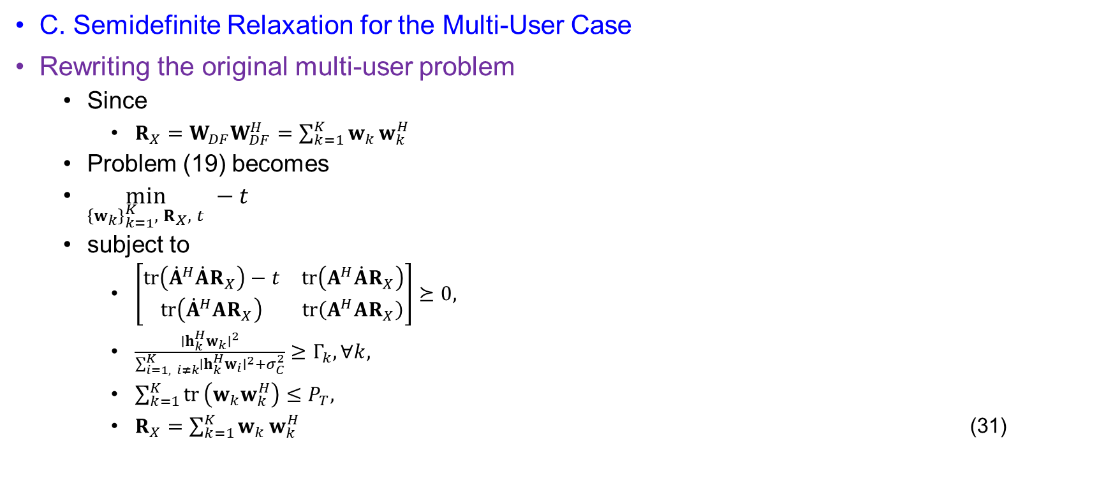
Joint Beamforming Design for Point Target
C. Semidefinite Relaxation for the Multi-User Case
Rewriting the original multi-user problem
  Since
    $R_{X}=W_{DF}W_{DF}^{H}=\sum_{k=1}^{K}{w_{k}}w_{k}^{H}$
  Problem (19) becomes
  $\min_{{\left\{w_{k}\right\}}_{k=1}^{K}, R_{X}, t} −t$
  subject to
    $\left[\begin{matrix}tr⁡\left({\dot{A}}^{H}\dot{A}R_{X}\right)−t & tr⁡\left(A^{H}\dot{A}R_{X}\right) \\ tr⁡\left({\dot{A}}^{H}AR_{X}\right) & tr⁡\left(A^{H}AR_{X}\right)\end{matrix}\right]⪰0,$
    $\frac{∣h_{k}^{H}w_{k}∣^{2}}{\sum_{i=1, i≠k}^{K}{∣}h_{k}^{H}w_{i}∣^{2}+σ_{C}^{2}}≥Γ_{k}, ∀k,$
    $\sum_{k=1}^{K}{tr}⁡\left(w_{k}w_{k}^{H}\right)≤P_{T},$
    $R_{X}=\sum_{k=1}^{K}{w_{k}}w_{k}^{H}$ (31)

Slide 31
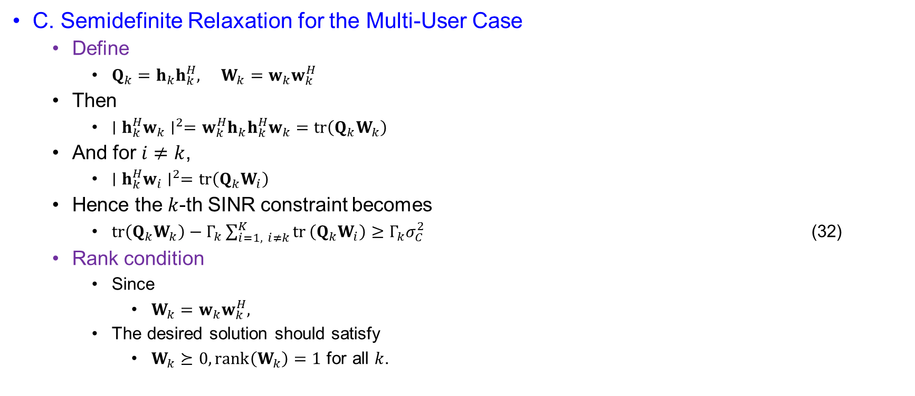
Joint Beamforming Design for Point Target
C. Semidefinite Relaxation for the Multi-User Case
  Define
    $Q_{k}=h_{k}h_{k}^{H}, W_{k}=w_{k}w_{k}^{H}$
  Then
    $∣h_{k}^{H}w_{k}∣^{2}=w_{k}^{H}h_{k}h_{k}^{H}w_{k}=tr⁡\left(Q_{k}W_{k}\right)$
  And for $i≠k$,
    $∣h_{k}^{H}w_{i}∣^{2}=tr⁡\left(Q_{k}W_{i}\right)$
  Hence the $k$-th SINR constraint becomes
    $tr⁡\left(Q_{k}W_{k}\right)−Γ_{k}\sum_{i=1, i≠k}^{K}{tr}⁡\left(Q_{k}W_{i}\right)≥Γ_{k}σ_{C}^{2}$ (32)
  Rank condition
    Since
      $W_{k}=w_{k}w_{k}^{H},$
    The desired solution should satisfy
      $W_{k}⪰0, rank⁡\left(W_{k}\right)=1$ for all $k$.

Slide 32
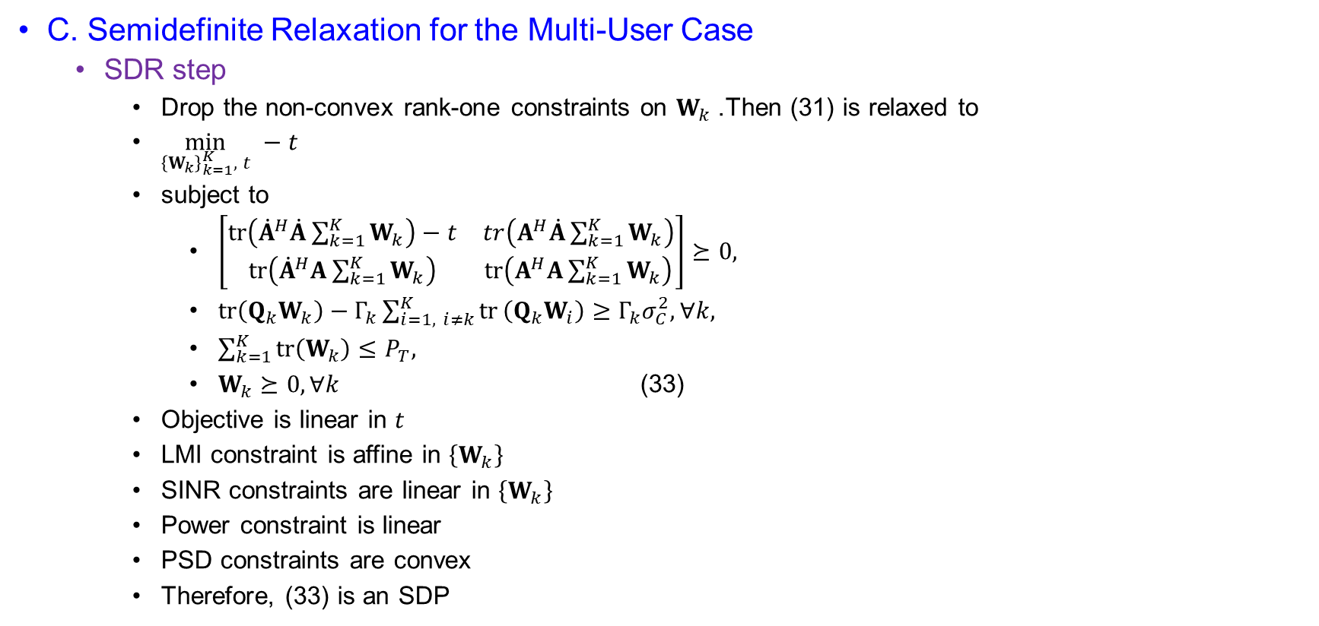
Joint Beamforming Design for Point Target
C. Semidefinite Relaxation for the Multi-User Case
  SDR step
    Drop the non-convex rank-one constraints on $W_{k}$. Then (31) is relaxed to
    $\min_{{\left\{W_{k}\right\}}_{k=1}^{K}, t} −t$
    subject to
      $\left[\begin{matrix}tr\left({\dot{A}}^{H}\dot{A}\sum_{k=1}^{K}{W_{k}}\right)−t & tr\left(A^{H}\dot{A}\sum_{k=1}^{K}{W_{k}}\right) \\ tr\left({\dot{A}}^{H}A\sum_{k=1}^{K}{W_{k}}\right) & tr\left(A^{H}A\sum_{k=1}^{K}{W_{k}}\right)\end{matrix}\right]⪰0,$
      $tr⁡\left(Q_{k}W_{k}\right)−Γ_{k}\sum_{i=1, i≠k}^{K}{tr}⁡\left(Q_{k}W_{i}\right)≥Γ_{k}σ_{C}^{2}, ∀k,$
      $\sum_{k=1}^{K}{tr}\left(W_{k}\right)≤P_{T},$
      $W_{k}⪰0, ∀k$ (33)
    Objective is linear in $t$
    LMI constraint is affine in $\left\{W_{k}\right\}$
    SINR constraints are linear in $\left\{W_{k}\right\}$
    Power constraint is linear
    PSD constraints are convex
    Therefore, (33) is an SDP

Slide 33
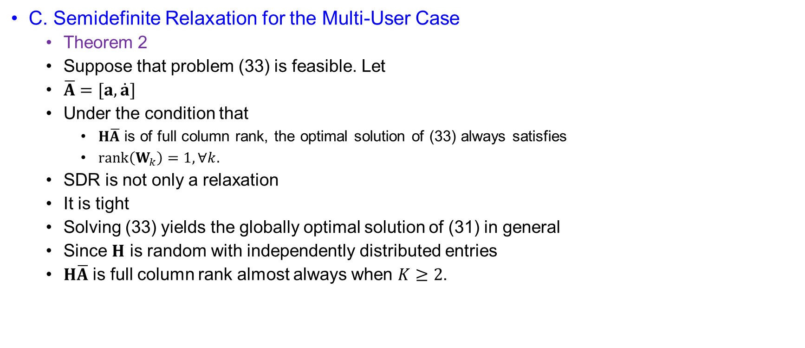
Joint Beamforming Design for Point Target
C. Semidefinite Relaxation for the Multi-User Case
  Theorem 2
  Suppose that problem (33) is feasible. Let
  $\overline{A}=[a, \dot{a}]$
  Under the condition that
    $H\overline{A}$ is of full column rank, the optimal solution of (33) always satisfies
    $rank⁡\left(W_{k}\right)=1, ∀k.$
  SDR is not only a relaxation
  It is tight
  Solving (33) yields the globally optimal solution of (31) in general
  Since $H$ is random with independently distributed entries
  $H\overline{A}$ is full column rank almost always when $K≥2$.

Slide 34
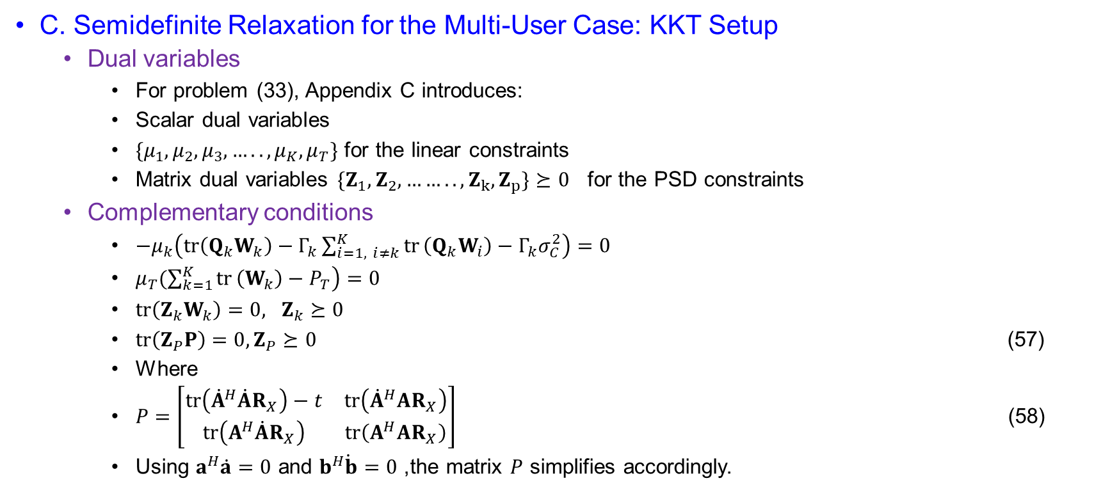
Joint Beamforming Design for Point Target
C. Semidefinite Relaxation for the Multi-User Case: KKT Setup
  Dual variables
    For problem (33), Appendix C introduces:
    Scalar dual variables
    $\{μ_{1}, μ_{2}, μ_{3},…..,μ_{K}, μ_{T}\}$ for the linear constraints
    Matrix dual variables $\{Z_{1}, Z_{2}, …….., Z_{k}, Z_{p}\}⪰0$ for the PSD constraints
  Complementary conditions
    $−μ_{k}\left(tr⁡\left(Q_{k}W_{k}\right)−Γ_{k}\sum_{i=1, i≠k}^{K}{tr}⁡\left(Q_{k}W_{i}\right)−Γ_{k}σ_{C}^{2}\right)=0$
    $μ_{T}\left.(\sum_{k=1}^{K}{tr}⁡\left(W_{k}\right)−P_{T}\right)=0$
    $\operatorname{tr}\left(Z_{k}W_{k}\right)=0, Z_{k}⪰0$
    $tr⁡\left(Z_{P}P\right)=0, Z_{P}⪰0$ (57)
    Where
    $P=\left[\begin{matrix}tr⁡\left({\dot{A}}^{H}\dot{A}R_{X}\right)−t & tr⁡\left({\dot{A}}^{H}AR_{X}\right) \\ tr⁡\left(A^{H}\dot{A}R_{X}\right) & tr⁡\left(A^{H}AR_{X}\right)\end{matrix}\right]$ (58)
    Using $a^{H}\dot{a}=0$ and $b^{H}\dot{b}=0$, the matrix $P$ simplifies accordingly.

Slide 35
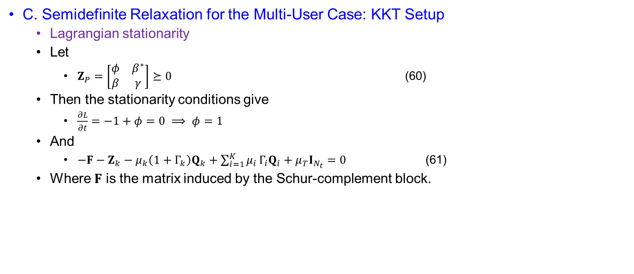
Joint Beamforming Design for Point Target
C. Semidefinite Relaxation for the Multi-User Case: KKT Setup
  Lagrangian stationarity
  Let
    $Z_{P}=\left[\begin{matrix}φ & β^{∗} \\ β & γ\end{matrix}\right]⪰0$ (60)
  Then the stationarity conditions give
    $\frac{∂L}{∂t}=−1+φ=0 ⟹ φ=1$
  And
    $−F−Z_{k}−μ_{k}\left(1+Γ_{k}\right)Q_{k}+\sum_{i=1}^{K}{μ_{i}}Γ_{i}Q_{i}+μ_{T}I_{N_{t}}=0$ (61)
  Where $F$ is the matrix induced by the Schur-complement block.

Slide 36
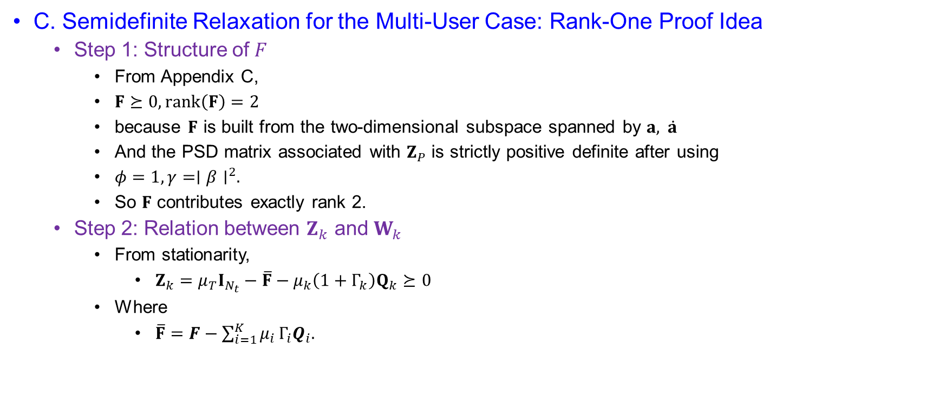
Joint Beamforming Design for Point Target
C. Semidefinite Relaxation for the Multi-User Case: Rank-One Proof Idea
  Step 1: Structure of $F$
    From Appendix C,
    $F⪰0, rank⁡\left(F\right)=2$
    because $F$ is built from the two-dimensional subspace spanned by $a, \dot{a}$
    And the PSD matrix associated with $Z_{P}$ is strictly positive definite after using
    $φ=1, γ=∣β∣^{2}.$
    So $F$ contributes exactly rank 2.
  Step 2: Relation between $Z_{k}$ and $W_{k}$
    From stationarity,
      $Z_{k}=μ_{T}I_{N_{t}}−\overline{F}−μ_{k}\left(1+Γ_{k}\right)Q_{k}⪰0$
    Where
      $\overline{F}=F−\sum_{i=1}^{K}{μ_{i}}Γ_{i}Q_{i}.$

Slide 37
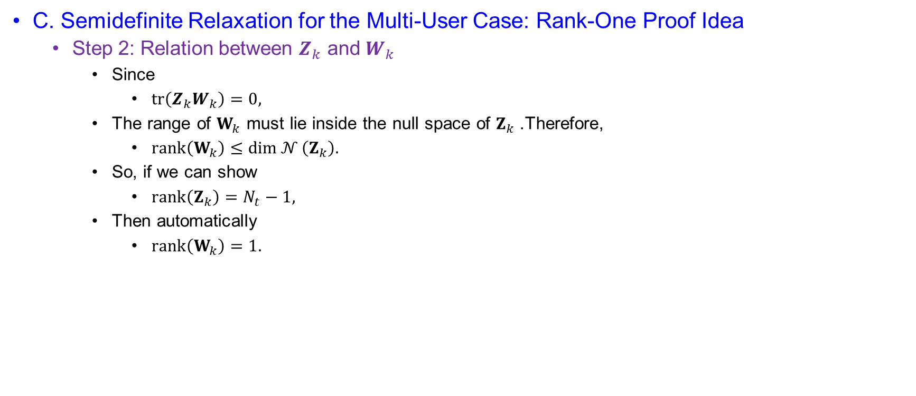
Joint Beamforming Design for Point Target
C. Semidefinite Relaxation for the Multi-User Case: Rank-One Proof Idea
  Step 2: Relation between $Z_{k}$ and $W_{k}$
    Since
      $tr⁡\left(Z_{k}W_{k}\right)=0,$
    The range of $W_{k}$ must lie inside the null space of $Z_{k}$. Therefore,
      $rank⁡\left(W_{k}\right)≤\dim{𝒩}\left(Z_{k}\right).$
    So, if we can show
      $rank⁡\left(Z_{k}\right)=N_{t}−1,$
    Then automatically
      $rank⁡\left(W_{k}\right)=1.$

Slide 38
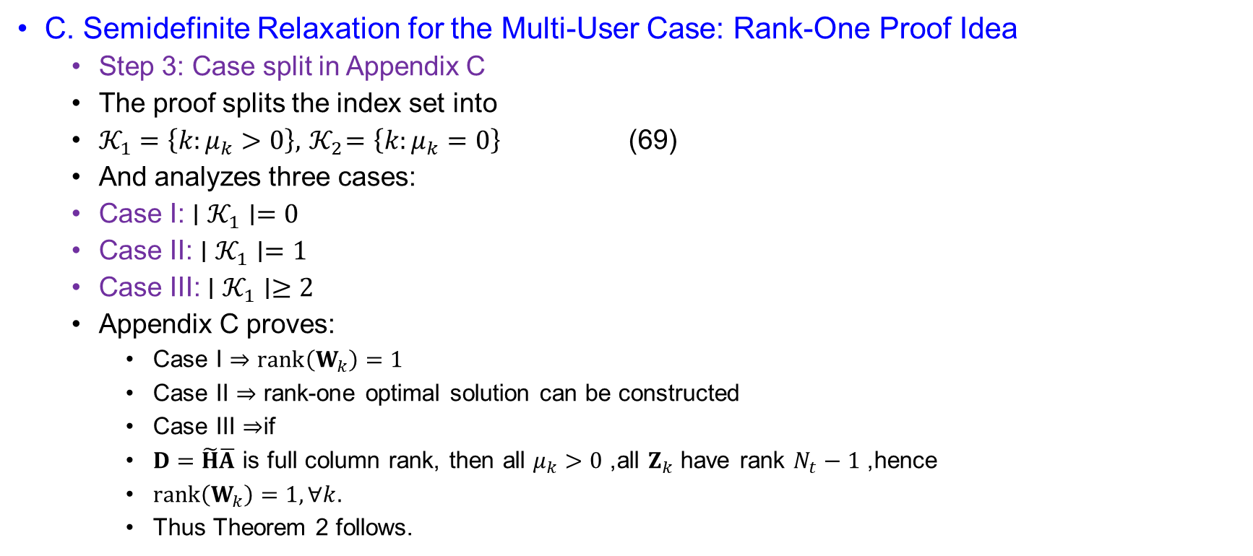
Joint Beamforming Design for Point Target
C. Semidefinite Relaxation for the Multi-User Case: Rank-One Proof Idea
  Step 3: Case split in Appendix C
  The proof splits the index set into
  $𝒦_{1}=\left\{k:μ_{k}>0\right\}, { 𝒦}_{2}=\left\{k:μ_{k}=0\right\}$ (69)
  And analyzes three cases:
  Case I: $∣𝒦_{1}∣=0$
  Case II: $∣𝒦_{1}∣=1$
  Case III: $∣𝒦_{1}∣≥2$
  Appendix C proves:
    Case I $⇒rank⁡\left(W_{k}\right)=1$
    Case II $⇒$ rank-one optimal solution can be constructed
    Case III $⇒$if
    $D=\tilde{H}\overline{A}$ is full column rank, then all $μ_{k}>0$, all $Z_{k}$ have rank $N_{t}−1$, hence
    $rank⁡\left(W_{k}\right)=1, ∀k.$
    Thus Theorem 2 follows.

Slide 39
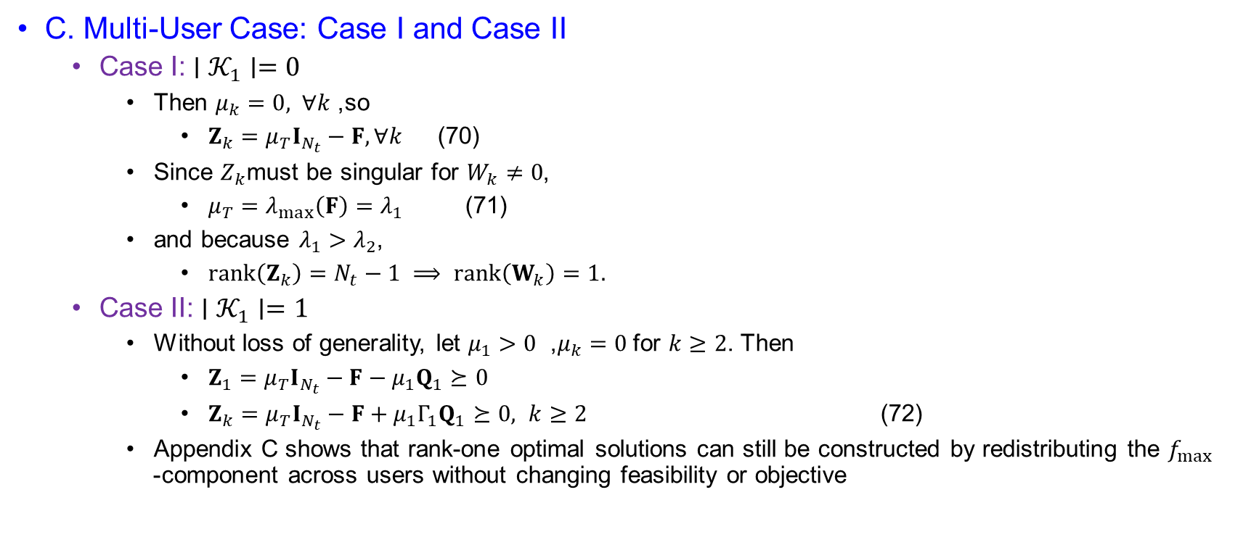
Joint Beamforming Design for Point Target
C. Multi-User Case: Case I and Case II
  Case I: $∣𝒦_{1}∣=0$
    Then $μ_{k}=0, ∀k$, so
      $Z_{k}=μ_{T}I_{N_{t}}−F, ∀k$ (70)
    Since $Z_{k}$must be singular for $W_{k}≠0$,
      $μ_{T}=λ_{max}\left(F\right)=λ_{1}$ (71)
    and because $λ_{1}>λ_{2}$,
      $rank⁡\left(Z_{k}\right)=N_{t}−1 ⟹ rank⁡\left(W_{k}\right)=1.$
  Case II: $∣𝒦_{1}∣=1$
    Without loss of generality, let $μ_{1}>0$ , $μ_{k}=0$for $k≥2$. Then
      $Z_{1}=μ_{T}I_{N_{t}}−F−μ_{1}Q_{1}⪰0$
      $Z_{k}=μ_{T}I_{N_{t}}−F+μ_{1}Γ_{1}Q_{1}⪰0, k≥2$ (72)
    Appendix C shows that rank-one optimal solutions can still be constructed by redistributing the $f_{max }$-component across users without changing feasibility or objective

Slide 40
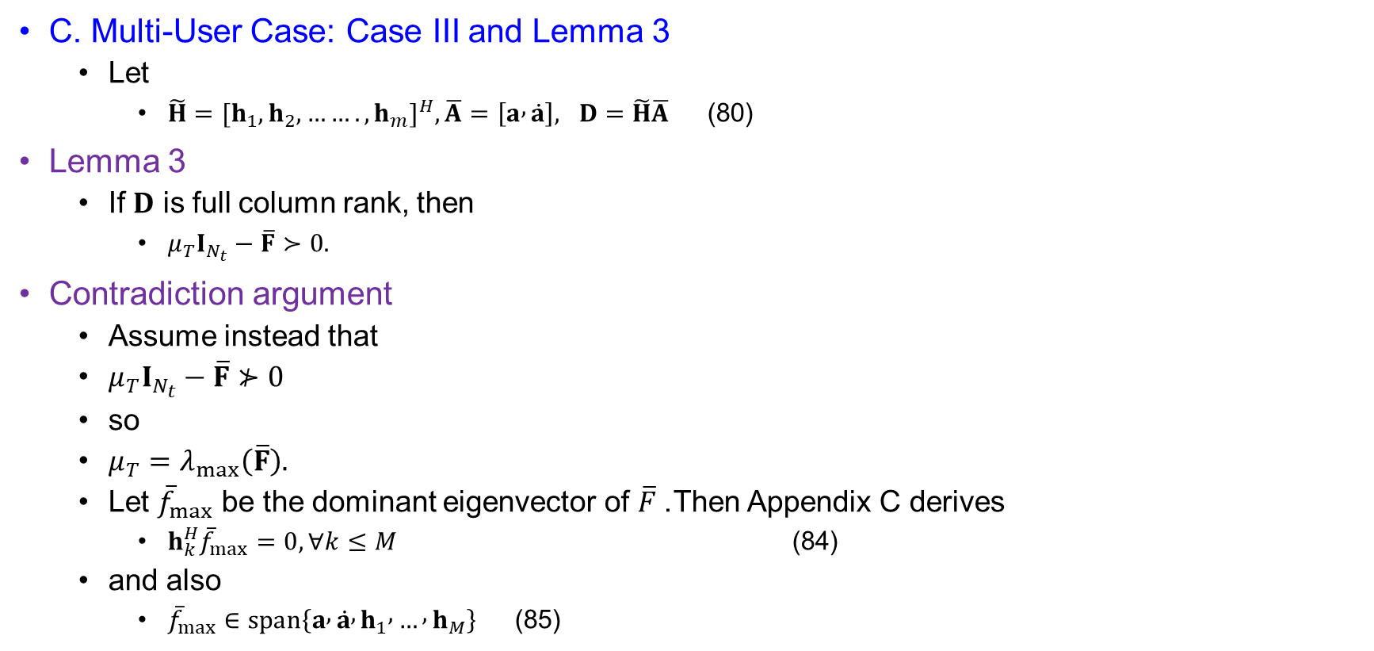
Joint Beamforming Design for Point Target
C. Multi-User Case: Case III and Lemma 3
  Let
    $\tilde{H}={[h_{1}, h_{2}, …….,h_{m}]}^{H}, \overline{A}=\left[a , \dot{a}\right], D=\tilde{H}\overline{A}$ (80)
Lemma 3
  If $D$ is full column rank, then
    $μ_{T}I_{N_{t}}−\overline{F}≻0.$
Contradiction argument
  Assume instead that
  $μ_{T}I_{N_{t}}−\overline{F}⊁0$
  so
  $μ_{T}=λ_{max}\left(\overline{F}\right).$
  Let ${\overline{f}}_{max}$ be the dominant eigenvector of $\overline{F}$. Then Appendix C derives
    $h_{k}^{H}{\overline{f}}_{max}=0, ∀k≤M$ (84)
  and also
    ${\overline{f}}_{max}∈span⁡\left\{a , \dot{a} , h_{1} , … , h_{M}\right\}$ (85)

Slide 41
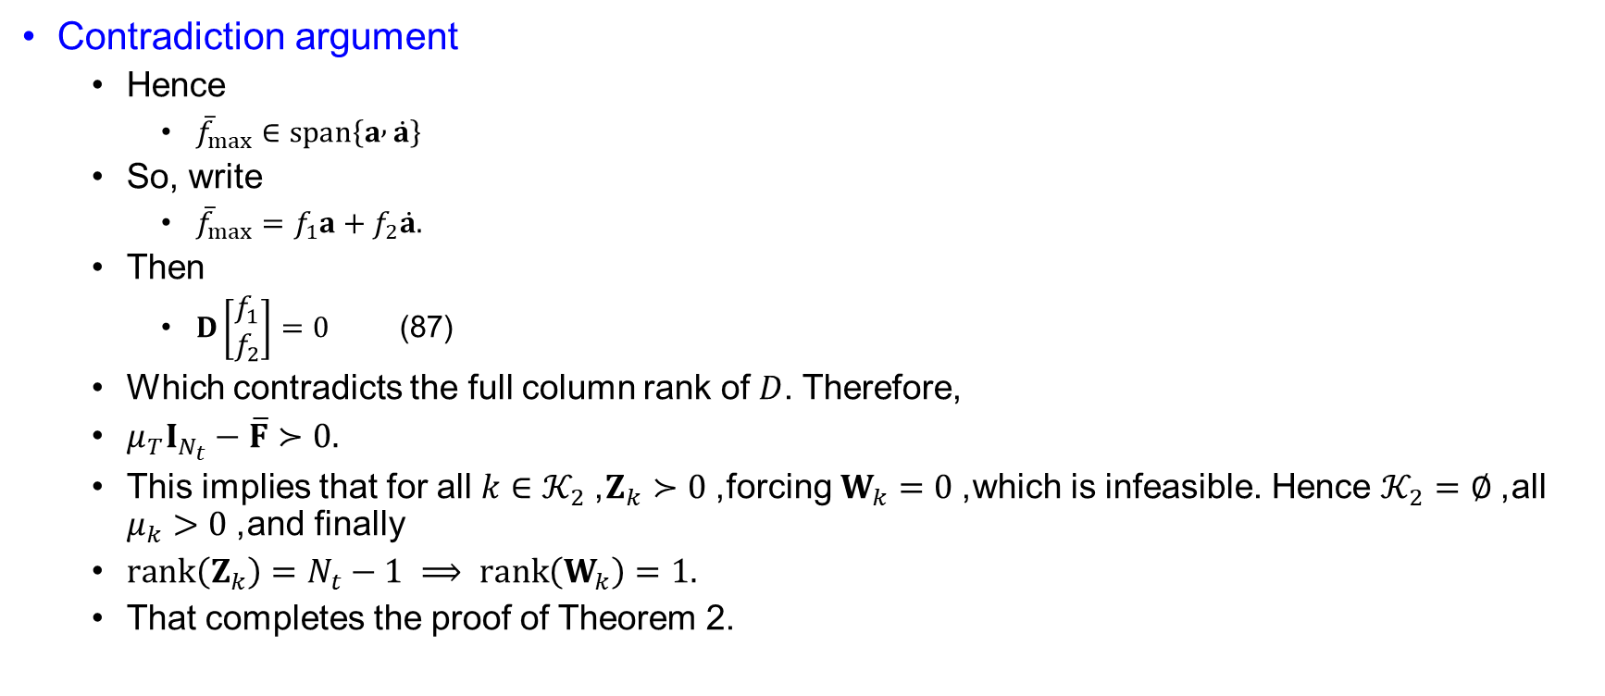
Joint Beamforming Design for Point Target
Contradiction argument
  Hence
    ${\overline{f}}_{max}∈span⁡\left\{a , \dot{a}\right\} \begin{matrix} & & & \end{matrix}$
  So, write
    ${\overline{f}}_{max}=f_{1}a+f_{2}\dot{a}.$
  Then
    $D\left[\begin{matrix}f_{1} \\ f_{2}\end{matrix}\right]=0$ (87)
  Which contradicts the full column rank of $D$. Therefore,
  $μ_{T}I_{N_{t}}−\overline{F}≻0.$
  This implies that for all $k∈𝒦_{2}$, $Z_{k}≻0$, forcing $W_{k}=0$, which is infeasible. Hence $𝒦_{2}=∅$, all $μ_{k}>0$, and finally
  $rank⁡\left(Z_{k}\right)=N_{t}−1 ⟹ rank⁡\left(W_{k}\right)=1.$
  That completes the proof of Theorem 2.

Slide 42
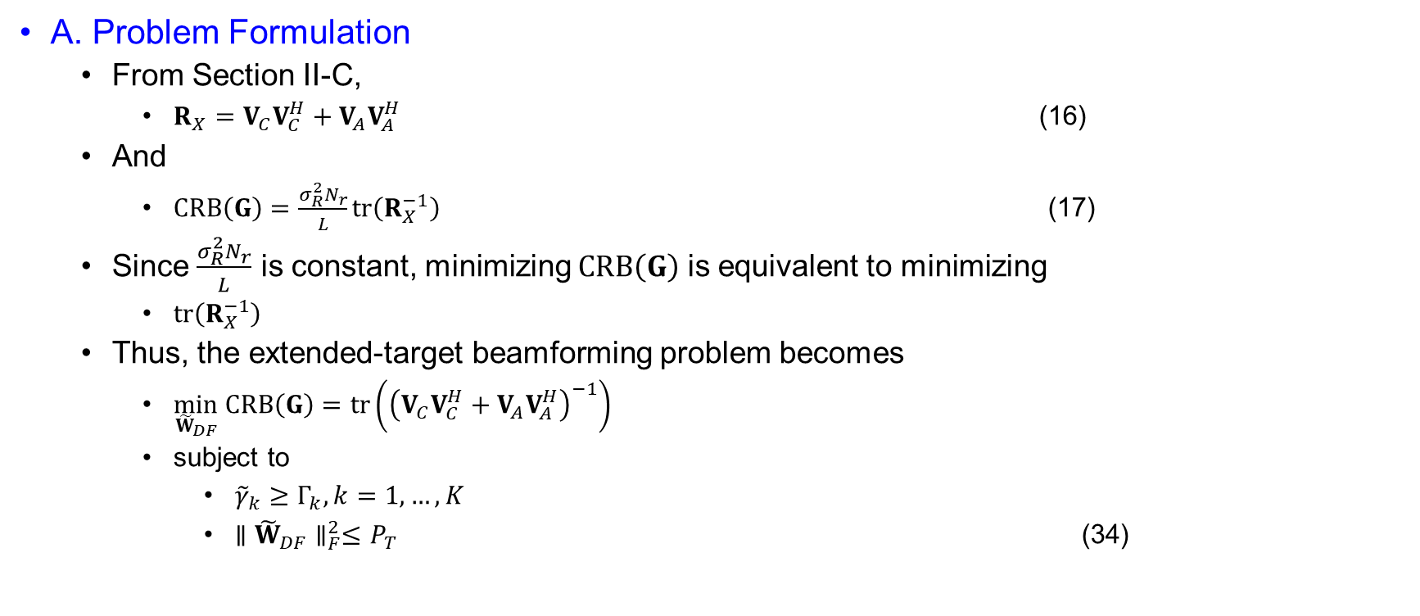
Joint Beamforming Design for Extended Target
A. Problem Formulation
  From Section II-C,
    $R_{X}=V_{C}V_{C}^{H}+V_{A}V_{A}^{H}$ (16)
  And
    $CRB⁡\left(G\right)=\frac{σ_{R}^{2}N_{r}}{L}tr⁡\left(R_{X}^{−1}\right)$ (17)
  Since $\frac{σ_{R}^{2}N_{r}}{L}$ is constant, minimizing $CRB⁡\left(G\right)$ is equivalent to minimizing
    $tr⁡\left(R_{X}^{−1}\right)$
  Thus, the extended-target beamforming problem becomes
    $\min_{{\tilde{W}}_{DF}} CRB⁡\left(G\right)=tr\left({\left(V_{C}V_{C}^{H}+V_{A}V_{A}^{H}\right)}^{−1}\right)$
    subject to
      ${\tilde{γ}}_{k}≥Γ_{k}, k=1,…,K$
      $∥{\tilde{W}}_{DF}∥_{F}^{2}≤P_{T}$ (34)

Slide 43
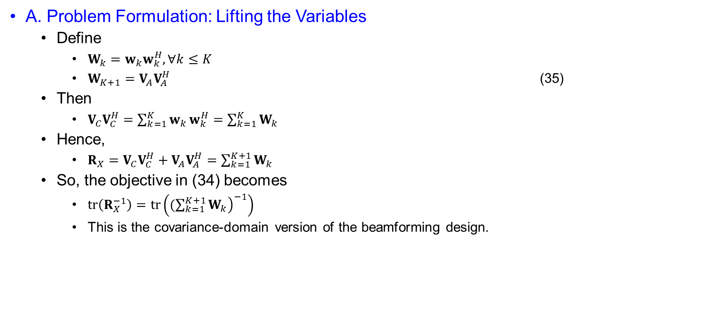
Joint Beamforming Design for Extended Target
A. Problem Formulation: Lifting the Variables
  Define
    $W_{k}=w_{k}w_{k}^{H}, ∀k≤K$
    $W_{K+1}=V_{A}V_{A}^{H}$ (35)
  Then
    $V_{C}V_{C}^{H}=\sum_{k=1}^{K}{w_{k}}w_{k}^{H}=\sum_{k=1}^{K}{W_{k}}$
  Hence,
    $R_{X}=V_{C}V_{C}^{H}+V_{A}V_{A}^{H}=\sum_{k=1}^{K+1}{W_{k}}$
  So, the objective in (34) becomes
    $tr⁡\left(R_{X}^{−1}\right)=tr\left({\left.(\sum_{k=1}^{K+1}{W_{k}}\right)}^{−1}\right)$
    This is the covariance-domain version of the beamforming design.

Slide 44
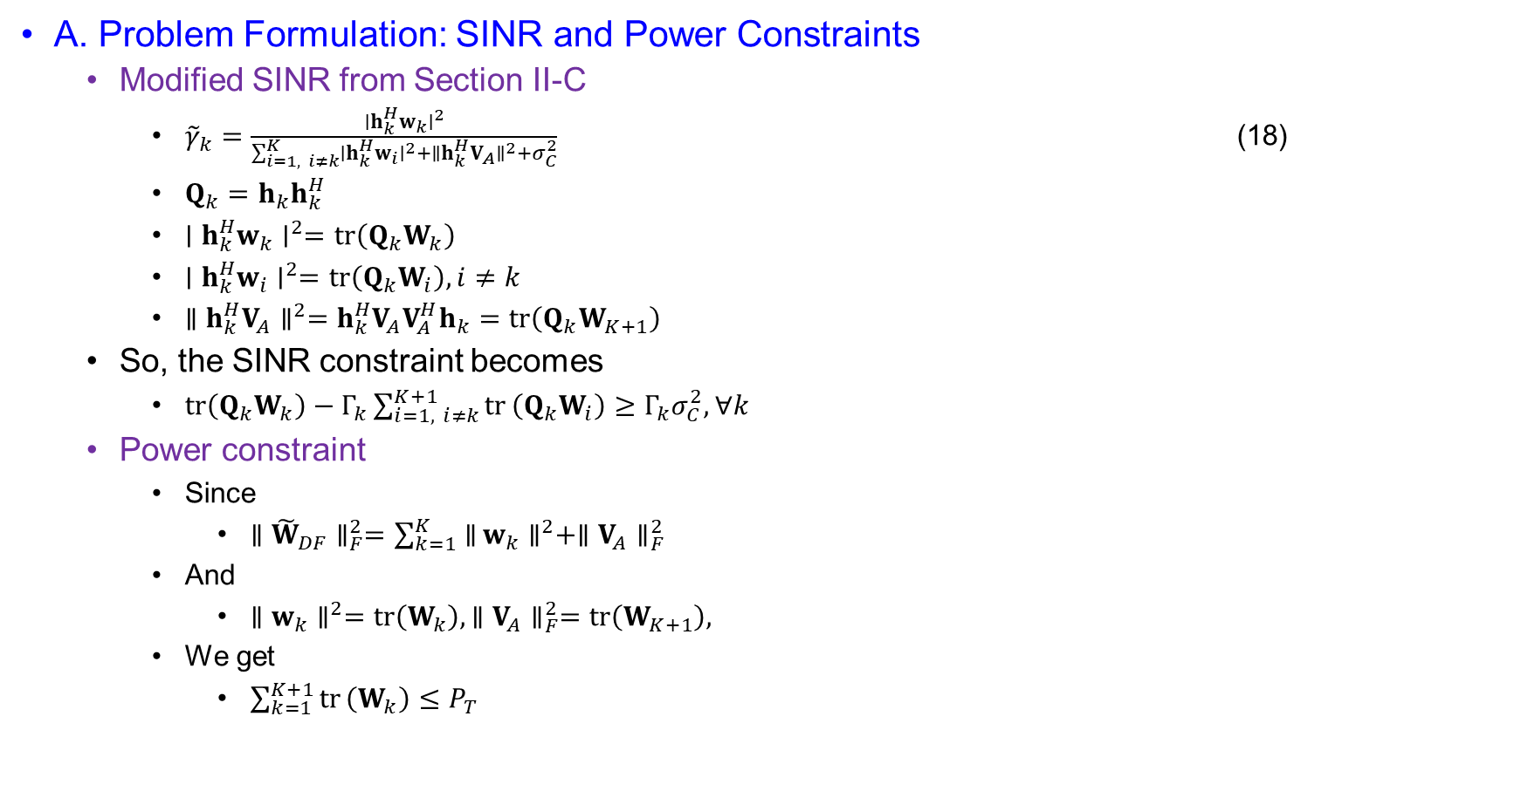
Joint Beamforming Design for Extended Target
A. Problem Formulation: SINR and Power Constraints
  Modified SINR from Section II-C
    ${\tilde{γ}}_{k}=\frac{∣h_{k}^{H}w_{k}∣^{2}}{\sum_{i=1, i≠k}^{K}{∣}h_{k}^{H}w_{i}∣^{2}+∥h_{k}^{H}V_{A}∥^{2}+σ_{C}^{2}}$ (18)
    $Q_{k}=h_{k}h_{k}^{H}$
    $∣h_{k}^{H}w_{k}∣^{2}=tr⁡\left(Q_{k}W_{k}\right)$
    $∣h_{k}^{H}w_{i}∣^{2}=tr⁡\left(Q_{k}W_{i}\right), i≠k$
    $∥h_{k}^{H}V_{A}∥^{2}=h_{k}^{H}V_{A}V_{A}^{H}h_{k}=tr⁡\left(Q_{k}W_{K+1}\right)$
  So, the SINR constraint becomes
    $tr⁡\left(Q_{k}W_{k}\right)−Γ_{k}\sum_{i=1, i≠k}^{K+1}{tr}⁡\left(Q_{k}W_{i}\right)≥Γ_{k}σ_{C}^{2}, ∀k$
  Power constraint
    Since
      $∥{\tilde{W}}_{DF}∥_{F}^{2}=\sum_{k=1}^{K}{∥}w_{k}∥^{2}+∥V_{A}∥_{F}^{2}$
    And
      $∥w_{k}∥^{2}=tr⁡\left(W_{k}\right), ∥V_{A}∥_{F}^{2}=tr⁡\left(W_{K+1}\right),$
    We get
      $\sum_{k=1}^{K+1}{tr}⁡\left(W_{k}\right)≤P_{T}$

Slide 45
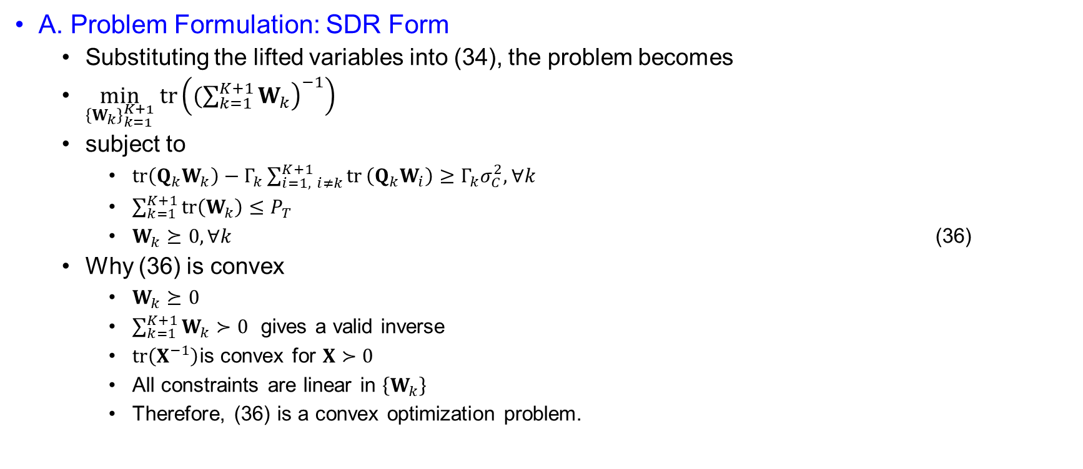
Joint Beamforming Design for Extended Target
A. Problem Formulation: SDR Form
  Substituting the lifted variables into (34), the problem becomes
  $\min_{{\left\{W_{k}\right\}}_{k=1}^{K+1}} tr\left({\left.(\sum_{k=1}^{K+1}{W_{k}}\right)}^{−1}\right)$
  subject to
    $tr⁡\left(Q_{k}W_{k}\right)−Γ_{k}\sum_{i=1, i≠k}^{K+1}{tr}⁡\left(Q_{k}W_{i}\right)≥Γ_{k}σ_{C}^{2}, ∀k$
    $\sum_{k=1}^{K+1}{tr}\left(W_{k}\right)≤P_{T}$
    $W_{k}⪰0, ∀k$ (36)
  Why (36) is convex
    $W_{k}⪰0$
    $\sum_{k=1}^{K+1}{W_{k}}≻0$ gives a valid inverse
    $tr⁡\left(X^{−1}\right)$is convex for $X≻0$
    All constraints are linear in $\left\{W_{k}\right\}$
    Therefore, (36) is a convex optimization problem.

Slide 46
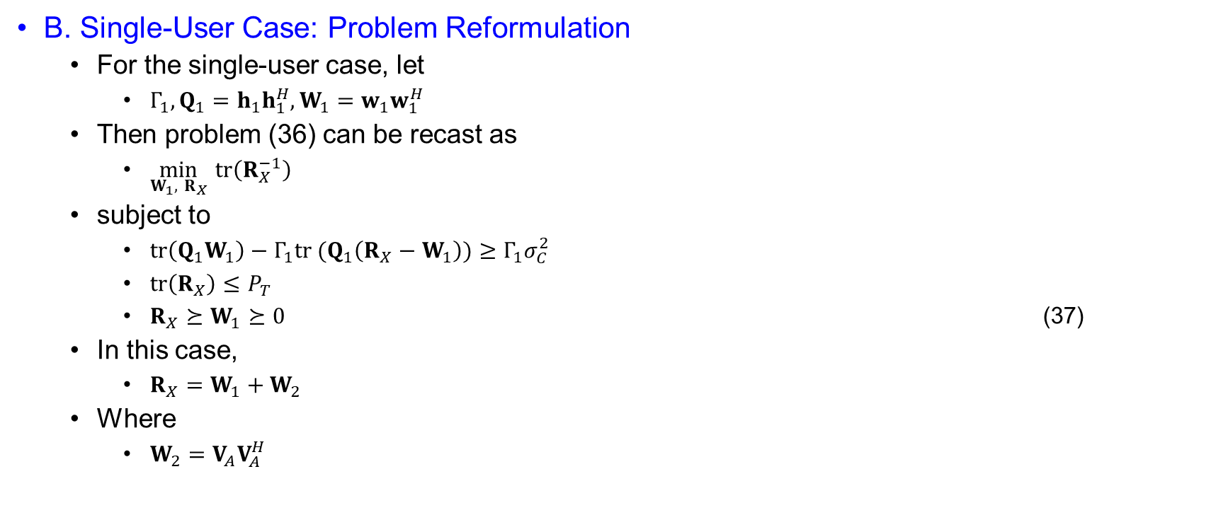
Joint Beamforming Design for Extended Target
B. Single-User Case: Problem Reformulation
  For the single-user case, let
    $Γ_{1}, Q_{1}=h_{1}h_{1}^{H}, W_{1}=w_{1}w_{1}^{H}$
  Then problem (36) can be recast as
    $\min_{W_{1}, R_{X}} tr⁡\left(R_{X}^{−1}\right)$
  subject to
    $tr⁡\left(Q_{1}W_{1}\right)−Γ_{1}tr (Q_{1}\left(R_{X}−W_{1}\right))≥Γ_{1}σ_{C}^{2}$
    $tr⁡\left(R_{X}\right)≤P_{T}$
    $R_{X}⪰W_{1}⪰0$ (37)
  In this case,
    $R_{X}=W_{1}+W_{2}$
  Where
    $W_{2}=V_{A}V_{A}^{H}$

Slide 47
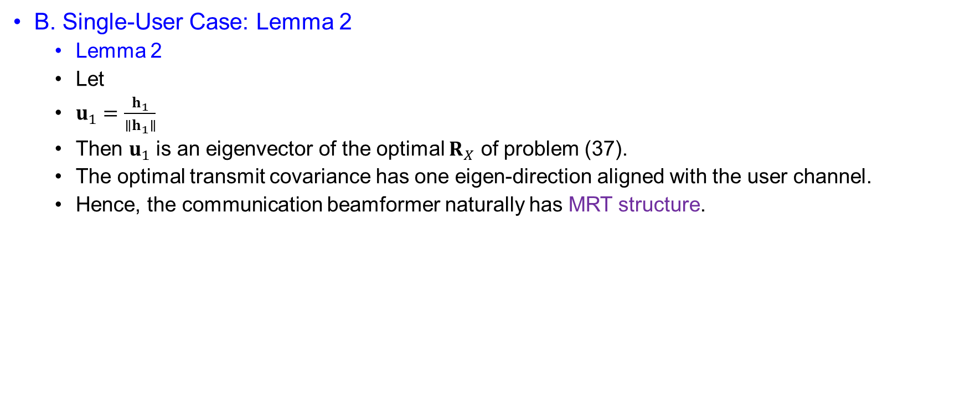
Joint Beamforming Design for Extended Target
B. Single-User Case: Lemma 2
  Lemma 2
  Let
  $u_{1}=\frac{h_{1}}{∥h_{1}∥}$
  Then $u_{1}$ is an eigenvector of the optimal $R_{X}$ of problem (37).
  The optimal transmit covariance has one eigen-direction aligned with the user channel.
  Hence, the communication beamformer naturally has MRT structure.

Slide 48
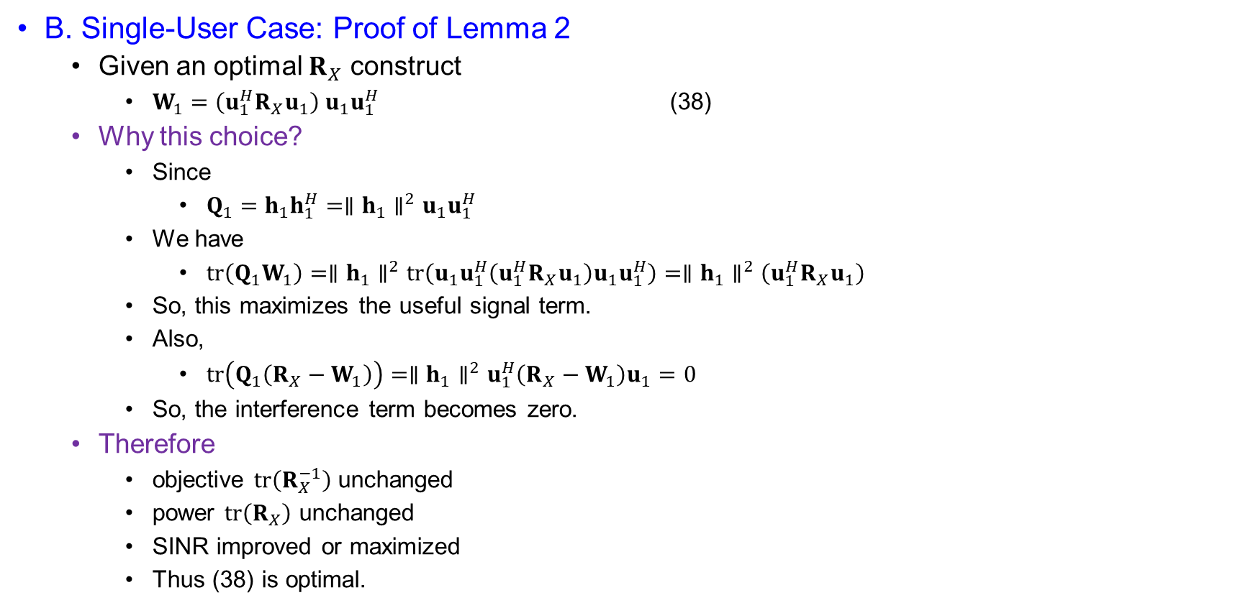
Joint Beamforming Design for Extended Target
B. Single-User Case: Proof of Lemma 2
  Given an optimal $R_{X}$ construct
    $W_{1}=\left(u_{1}^{H}R_{X}u_{1}\right) u_{1}u_{1}^{H}$ (38)
  Why this choice?
    Since
      $Q_{1}=h_{1}h_{1}^{H}=∥h_{1}∥^{2}u_{1}u_{1}^{H}$
    We have
      $tr⁡\left(Q_{1}W_{1}\right)=∥h_{1}∥^{2}tr⁡\left(u_{1}u_{1}^{H}\left(u_{1}^{H}R_{X}u_{1}\right)u_{1}u_{1}^{H}\right)=∥h_{1}∥^{2}\left(u_{1}^{H}R_{X}u_{1}\right)$
    So, this maximizes the useful signal term.
    Also,
      $tr⁡\left(Q_{1}\left(R_{X}−W_{1}\right)\right)=∥h_{1}∥^{2}u_{1}^{H}\left(R_{X}−W_{1}\right)u_{1}=0$
    So, the interference term becomes zero.
  Therefore
    objective $tr⁡\left(R_{X}^{−1}\right)$ unchanged
    power $tr⁡\left(R_{X}\right)$ unchanged
    SINR improved or maximized
    Thus (38) is optimal.

Slide 49
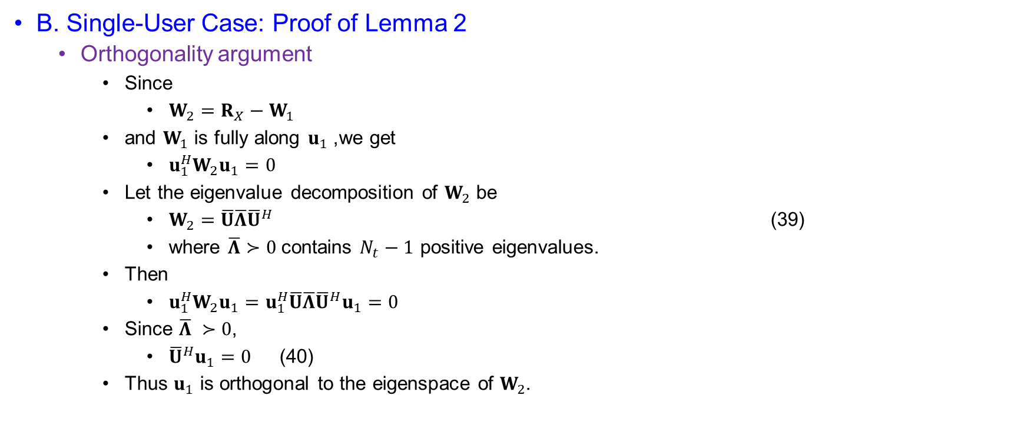
Joint Beamforming Design for Extended Target
B. Single-User Case: Proof of Lemma 2
  Orthogonality argument
    Since
      $W_{2}=R_{X}−W_{1}$
    and $W_{1}$ is fully along $u_{1}$, we get
      $u_{1}^{H}W_{2}u_{1}=0$
    Let the eigenvalue decomposition of $W_{2}$ be
      $W_{2}=\overline{U}\overline{Λ}{\overline{U}}^{H}$ (39)
      where $\overline{Λ}≻0$contains $N_{t}−1$ positive eigenvalues.
    Then
      $u_{1}^{H}W_{2}u_{1}=u_{1}^{H}\overline{U}\overline{Λ}{\overline{U}}^{H}u_{1}=0$
    Since $\overline{Λ} ≻0$,
      ${\overline{U}}^{H}u_{1}=0$ (40)
    Thus $u_{1}$ is orthogonal to the eigenspace of $W_{2}$.

Slide 50

Joint Beamforming Design for Extended Target
B. Single-User Case: Proof of Lemma 2
  Orthogonality argument
    Now define
      $λ_{11}=u_{1}^{H}R_{X}u_{1}>0$
      $\overline{Λ}=diag\{λ_{22},λ_{33},…….,λ_{N_{t}N_{t}}\}$
      $U=[u_{1},\overline{U}]$
      $Λ=\left[\begin{matrix}λ_{11} & 0 \\ 0 & \overline{Λ}\end{matrix}\right]$
    Hence,
      $R_{X}=W_{1}+W_{2}=λ_{11}u_{1}u_{1}^{H}+\overline{U}\overline{Λ}{\overline{U}}^{H}=UΛU^{H}$
      So $u_{1}$ is an eigenvector of $R_{X}$.

Slide 51
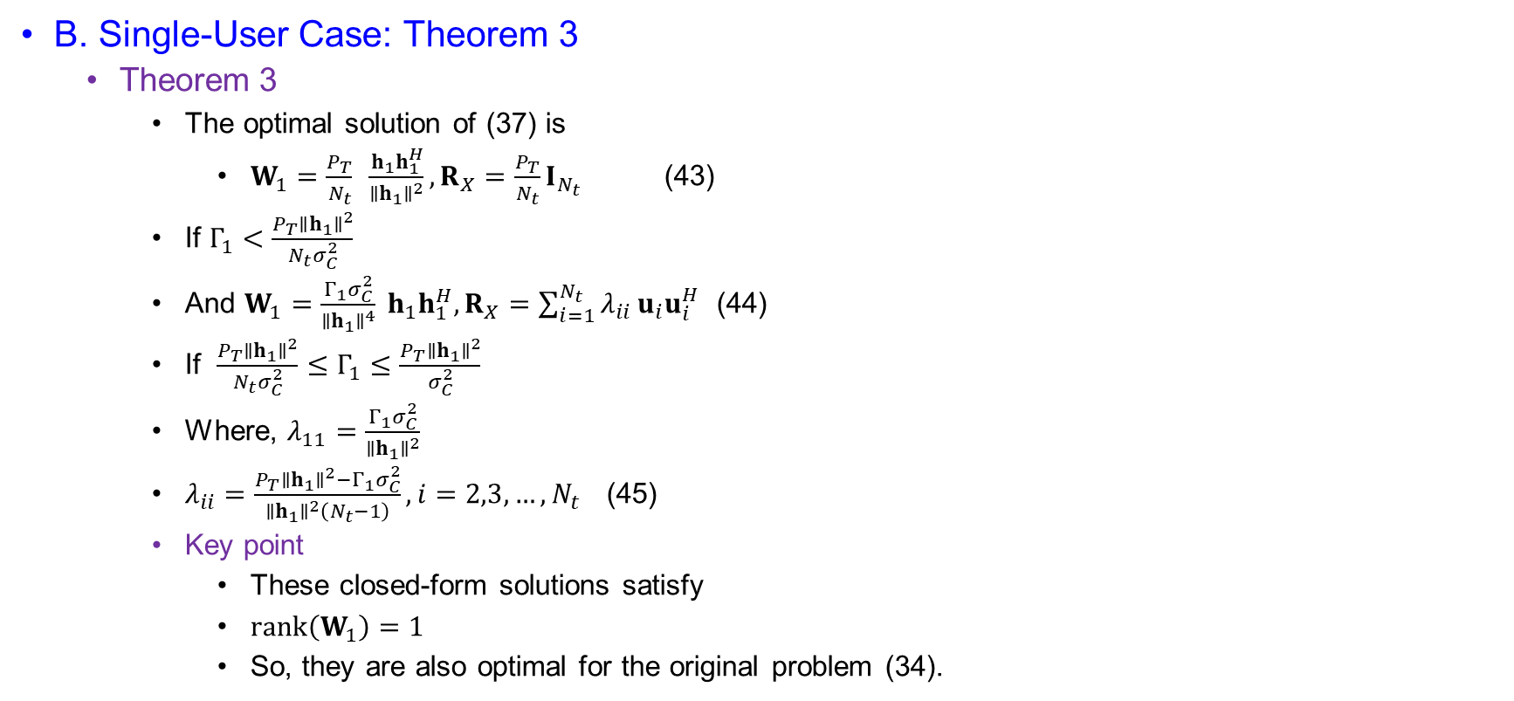
Joint Beamforming Design for Extended Target
B. Single-User Case: Theorem 3
  Theorem 3
    The optimal solution of (37) is
      $W_{1}=\frac{P_{T}}{N_{t}} \frac{h_{1}h_{1}^{H}}{∥h_{1}∥^{2}}, R_{X}=\frac{P_{T}}{N_{t}}I_{N_{t}}$ (43)
    If $Γ_{1}<\frac{P_{T}∥h_{1}∥^{2}}{N_{t}σ_{C}^{2}}$
    And $W_{1}=\frac{Γ_{1}σ_{C}^{2}}{∥h_{1}∥^{4}} h_{1}h_{1}^{H}, R_{X}=\sum_{i=1}^{N_{t}}{λ_{ii}}u_{i}u_{i}^{H}$ (44)
    If $\frac{P_{T}∥h_{1}∥^{2}}{N_{t}σ_{C}^{2}}≤Γ_{1}≤\frac{P_{T}∥h_{1}∥^{2}}{σ_{C}^{2}}$
    Where, $λ_{11}=\frac{Γ_{1}σ_{C}^{2}}{∥h_{1}∥^{2}}$
    $λ_{ii}=\frac{P_{T}∥h_{1}∥^{2}−Γ_{1}σ_{C}^{2}}{∥h_{1}∥^{2}\left(N_{t}−1\right)}, i=2,3,…,N_{t}$ (45)
    Key point
      These closed-form solutions satisfy
      $rank⁡\left(W_{1}\right)=1$
      So, they are also optimal for the original problem (34).

Slide 52
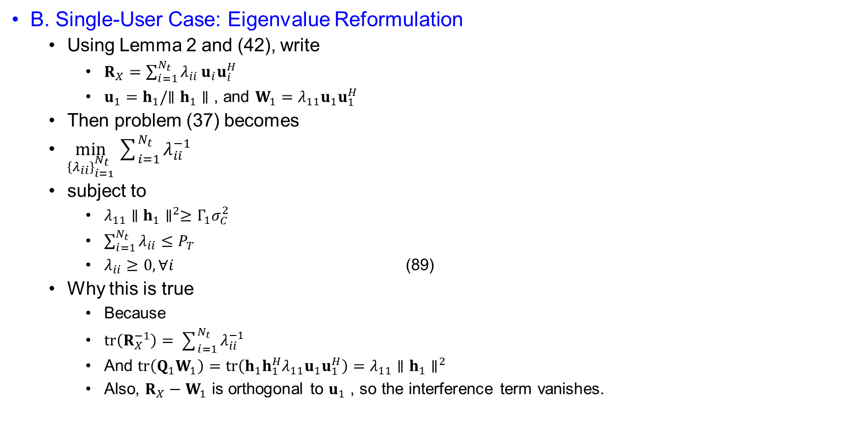
Joint Beamforming Design for Extended Target
B. Single-User Case: Eigenvalue Reformulation
  Using Lemma 2 and (42), write
    $R_{X}=\sum_{i=1}^{N_{t}}{λ_{ii}}u_{i}u_{i}^{H}$
    $u_{1}=h_{1}/∥h_{1}∥$, and $W_{1}=λ_{11}u_{1}u_{1}^{H}$
  Then problem (37) becomes
  $\min_{{\left\{λ_{ii}\right\}}_{i=1}^{N_{t}}}\sum_{i=1}^{N_{t}}{λ_{ii}^{−1}}$
  subject to
    $λ_{11}∥h_{1}∥^{2}≥Γ_{1}σ_{C}^{2}$
    $\sum_{i=1}^{N_{t}}{λ_{ii}}≤P_{T}$
    $λ_{ii}≥0, ∀i$ (89)
  Why this is true
    Because
    $tr⁡\left(R_{X}^{−1}\right)=\sum_{i=1}^{N_{t}}{λ_{ii}^{−1}}$
    And $tr⁡\left(Q_{1}W_{1}\right)=tr⁡\left(h_{1}h_{1}^{H}λ_{11}u_{1}u_{1}^{H}\right)=λ_{11}∥h_{1}∥^{2}$
    Also, $R_{X}−W_{1}$ is orthogonal to $u_{1}$, so the interference term vanishes.

Slide 53

Joint Beamforming Design for Extended Target
B. Single-User Case: KKT Conditions
  Form the Lagrangian
    $L=\sum_{i=1}^{N_{t}}{λ_{ii}^{−1}}+ω\left(−λ_{11}+\frac{Γ_{1}σ_{C}^{2}}{∥h_{1}∥^{2}}\right)+μ\left.(\sum_{i=1}^{N_{t}}{λ_{ii}}−P_{T}\right)−\sum_{i=1}^{N_{t}}{η_{i}}λ_{ii}$ (90)
    where $ω,μ,η_{i}$ are dual variables.
  KKT conditions
    $\frac{∂L}{∂λ_{11}}=−λ_{11}^{−2}−ω+μ−η_{1}=0$ (91a)
    $\frac{∂L}{∂λ_{ii}}=−λ_{ii}^{−2}+μ−η_{i}=0, i=2,3,…,N_{t}$ (91b)
    $ω\left(−λ_{11}+\frac{Γ_{1}σ_{C}^{2}}{∥h_{1}∥^{2}}\right)=0, ω≥0$ (91c)
    $μ\left.(\sum_{i=1}^{N_{t}}{λ_{ii}}−P_{T}\right)=0, μ≥0$ (91d)
    $η_{i}λ_{ii}=0, η_{i}≥0, λ_{ii}≥0$ (91e)
    Since $λ_{ii}>0$ , we get $η_{i}=0, ∀i$
    Thus,
      $λ_{11}^{−2}=μ−ω$ (92a)
      $λ_{ii}^{−2}=μ, i=2,3,…,N_{t}$ (92b)
    From (92b), $μ>0$, hence the power budget is active:
      $\sum_{i=1}^{N_{t}}{λ_{ii}}=P_{T}$

Slide 54

Joint Beamforming Design for Extended Target
B. Single-User Case: Closed-Form Cases
  Case 1: SINR constraint inactive
    If $ω=0$
    Then from (92a) and (92b),
    $λ_{11}^{−2}=λ_{ii}^{−2}=μ$
    So, all eigenvalues are equal:
      $λ_{ii}=\frac{P_{T}}{N_{t}}, ∀i$ (93)
    Hence,
      $W_{1}=\frac{P_{T}}{N_{t}}\frac{h_{1}h_{1}^{H}}{∥h_{1}∥^{2}}, R_{X}=\frac{P_{T}}{N_{t}}I_{N_{t}}$ (94)
    This requires
      $\frac{P_{T}}{N_{t}}>\frac{Γ_{1}σ_{C}^{2}}{∥h_{1}∥^{2}}$
      Or $Γ_{1}<\frac{P_{T}∥h_{1}∥^{2}}{N_{t}σ_{C}^{2}}$ (95)

Slide 55
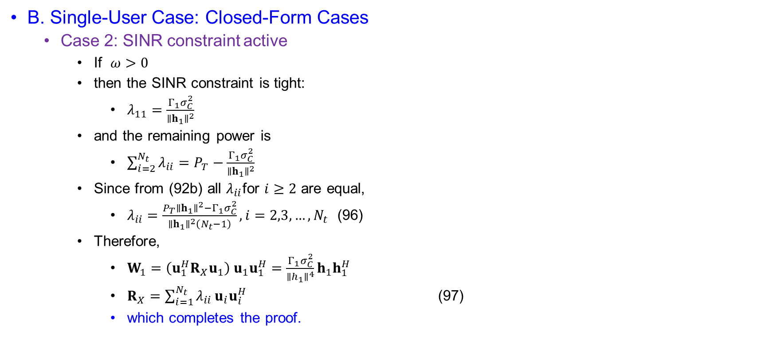
Joint Beamforming Design for Extended Target
B. Single-User Case: Closed-Form Cases
  Case 2: SINR constraint active
    If $ω>0$
    then the SINR constraint is tight:
      $λ_{11}=\frac{Γ_{1}σ_{C}^{2}}{∥h_{1}∥^{2}}$
    and the remaining power is
      $\sum_{i=2}^{N_{t}}{λ_{ii}}=P_{T}−\frac{Γ_{1}σ_{C}^{2}}{∥h_{1}∥^{2}}$
    Since from (92b) all $λ_{ii}$for $i≥2$ are equal,
      $λ_{ii}=\frac{P_{T}∥h_{1}∥^{2}−Γ_{1}σ_{C}^{2}}{∥h_{1}∥^{2}\left(N_{t}−1\right)}, i=2,3,…,N_{t}$ (96)
    Therefore,
      $W_{1}=\left(u_{1}^{H}R_{X}u_{1}\right) u_{1}u_{1}^{H}=\frac{Γ_{1}σ_{C}^{2}}{∥h_{1}∥^{4}}h_{1}h_{1}^{H}$
      $R_{X}=\sum_{i=1}^{N_{t}}{λ_{ii}}u_{i}u_{i}^{H}$ (97)
      which completes the proof.

Slide 56
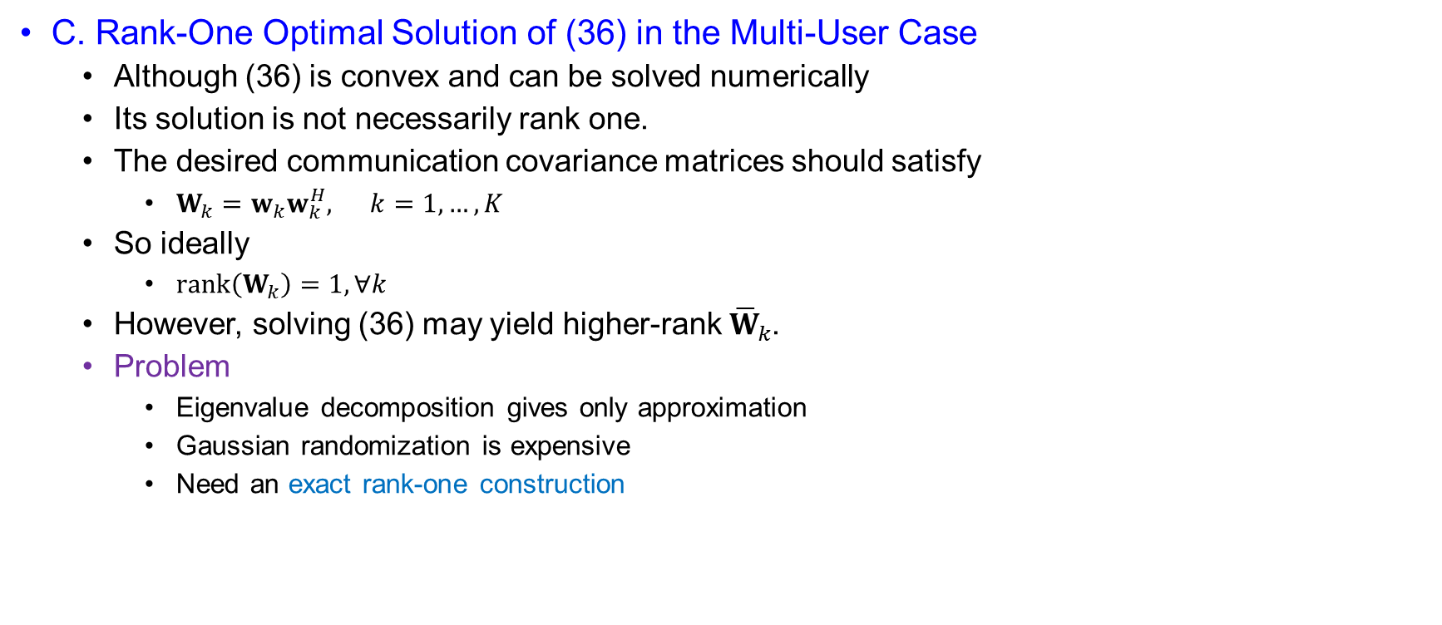
Joint Beamforming Design for Extended Target
C. Rank-One Optimal Solution of (36) in the Multi-User Case
  Although (36) is convex and can be solved numerically
  Its solution is not necessarily rank one.
  The desired communication covariance matrices should satisfy
    $W_{k}=w_{k}w_{k}^{H}, k=1,…,K$
  So ideally
    $rank⁡\left(W_{k}\right)=1, ∀k$
  However, solving (36) may yield higher-rank ${\overline{W}}_{k}$.
  Problem
    Eigenvalue decomposition gives only approximation
    Gaussian randomization is expensive
    Need an exact rank-one construction

Slide 57

Joint Beamforming Design for Extended Target
C. Rank-One Optimal Solution of (36) in the Multi-User Case
  Equivalent form of (36)
  Problem (36) can be written as
    $\min_{{\left\{W_{k}\right\}}_{k=1}^{K}, R_{X}} tr⁡\left(R_{X}^{−1}\right)$
  subject to
    $tr⁡\left(Q_{k}W_{k}\right)−Γ_{k}tr\left(Q_{k}\left(R_{X}−W_{k}\right)\right)≥Γ_{k}σ_{C}^{2}, ∀k$
    $tr⁡\left(R_{X}\right)≤P_{T}$
    $R_{X}⪰\sum_{k=1}^{K}{W_{k}}$
    $W_{k}⪰0, ∀k$ (46)
  This is the multi-user extended-target counterpart of (37).

Slide 58

Joint Beamforming Design for Extended Target
C. Rank-One Optimal Solution of (36): Theorem 4
  Let the optimal solution of (46) be
  ${\overline{R}}_{x}{\left\{{\overline{W}}_{k}\right\}}_{k=1}^{K}$
  If $rank⁡\left({\overline{W}}_{k}\right)=1, ∀k$
  then the relaxed solution is already optimal for the original problem.
  Otherwise, define
    ${\tilde{R}}_{X}={\overline{R}}_{X}$
    ${\tilde{W}}_{k}=\frac{{\overline{W}}_{k}Q_{k}{\overline{W}}_{k}^{H}}{tr⁡\left(Q_{k}{\overline{W}}_{k}\right)}, ∀k≤K$ (47)
  Then Theorem 4 states:
    $rank⁡\left({\tilde{W}}_{k}\right)=1, ∀k≤K$
    and ${\tilde{R}}_{X},\left\{{\tilde{W}}_{k}\right\}$ is also optimal.

Slide 59

Joint Beamforming Design for Extended Target
C. Rank-One Optimal Solution of (36): Why ${\tilde{W}}_{k}$is Rank One
  Recall
    $Q_{k}=h_{k}h_{k}^{H}$
  Substitute into (47):
    ${\tilde{W}}_{k}=\frac{{\overline{W}}_{k}h_{k}h_{k}^{H}{\overline{W}}_{k}^{H}}{h_{k}^{H}{\overline{W}}_{k}h_{k}}$
  Now define
    $v_{k}={\overline{W}}_{k}h_{k}$
  Then
    ${\tilde{W}}_{k}=\frac{v_{k}v_{k}^{H}}{h_{k}^{H}{\overline{W}}_{k}h_{k}}$
  Since $v_{k}v_{k}^{H}$ is an outer product of one vector with itself,
    $rank⁡\left({\tilde{W}}_{k}\right)=1$
    provided $v_{k}≠0$, which is guaranteed by feasibility.
  The construction in (47) compresses each ${\overline{W}}_{k}$ into a rank-one matrix along the user-relevant direction ${\overline{W}}_{k}h_{k}$.

Slide 60

Joint Beamforming Design for Extended Target
C. Rank-One Optimal Solution of (36): Useful Signal Preservation
  We now show that the useful signal power of user $k$ is unchanged.
  Original useful signal term:
    $tr⁡\left(Q_{k}{\overline{W}}_{k}\right)=h_{k}^{H}{\overline{W}}_{k}h_{k}$
  New useful signal term:
    $tr⁡\left(Q_{k}{\tilde{W}}_{k}\right)=\operatorname{tr}\left(Q_{k}\frac{{\overline{W}}_{k}Q_{k}{\overline{W}}_{k}^{H}}{tr⁡\left(Q_{k}{\overline{W}}_{k}\right)}\right)$
  Using $Q_{k}=h_{k}h_{k}^{H}$,
    $tr⁡\left(Q_{k}{\tilde{W}}_{k}\right)=\frac{tr⁡\left(h_{k}h_{k}^{H}{\overline{W}}_{k}h_{k}h_{k}^{H}{\overline{W}}_{k}^{H}\right)}{h_{k}^{H}{\overline{W}}_{k}h_{k}}=\frac{\left(h_{k}^{H}{\overline{W}}_{k}h_{k}\right)\left(h_{k}^{H}{\overline{W}}_{k}^{H}h_{k}\right)}{h_{k}^{H}{\overline{W}}_{k}h_{k}}$
  Since ${\overline{W}}_{k}$ is Hermitian,
    $h_{k}^{H}{\overline{W}}_{k}^{H}h_{k}=h_{k}^{H}{\overline{W}}_{k}h_{k}$
  Therefore,
    $tr⁡\left(Q_{k}{\tilde{W}}_{k}\right)=h_{k}^{H}{\overline{W}}_{k}h_{k}=tr⁡\left(Q_{k}{\overline{W}}_{k}\right)$
  Conclusion
    The useful signal power is preserved exactly.

Slide 61

Joint Beamforming Design for Extended Target
C. Rank-One Optimal Solution of (36): Objective and Power Preservation
  The construction uses
    ${\tilde{R}}_{X}={\overline{R}}_{X}$
  Hence the objective remains unchanged:
    $tr⁡\left({\tilde{R}}_{X}^{−1}\right)=tr⁡\left({\overline{R}}_{X}^{−1}\right)$
  So, the CRB objective is identical.
    Also, the total power remains unchanged:
    $tr⁡\left({\tilde{R}}_{X}\right)=tr⁡\left({\overline{R}}_{X}\right)≤P_{T}$
  Thus:
    same objective value
    same total transmit power
    same total covariance
    Key insight
      The rank-one extraction modifies only the decomposition of $R_{X}$ , not $R_{X}$ itself.

Slide 62

Joint Beamforming Design for Extended Target
C. Rank-One Optimal Solution of (36): SINR Preservation
  For user $k$, the SINR constraint in (46) is
    $tr⁡\left(Q_{k}W_{k}\right)−Γ_{k}\operatorname{tr}{(Q_{k}\left(R_{X}−W_{k}\right))}≥Γ_{k}σ_{C}^{2}$
  Now after replacement:
    $R_{X}$ is unchanged
    $tr⁡\left(Q_{k}W_{k}\right)$ is unchanged
  Therefore,
    $\operatorname{tr}\left(Q_{k}\left({\tilde{R}}_{X}−{\tilde{W}}_{k}\right)\right)=tr\left(Q_{k}\left({\overline{R}}_{X}−{\overline{W}}_{k}\right)\right)$
  Hence the interference term is also unchanged.
  So, for every user $k$,
    $tr⁡\left(Q_{k}{\tilde{W}}_{k}\right)−Γ_{k}\operatorname{tr}\left(Q_{k}\left({\tilde{R}}_{X}−{\tilde{W}}_{k}\right)\right)=tr⁡\left(Q_{k}{\overline{W}}_{k}\right)−Γ_{k}tr\left(Q_{k}\left({\overline{R}}_{X}−{\overline{W}}_{k}\right)\right)$
  Therefore, the SINR constraint remains satisfied.
  Conclusion
    The new rank-one solution is feasible and optimal.

Slide 63

Joint Beamforming Design for Extended Target
C. Rank-One Optimal Solution of (36): Recovering $w_{k}$
  Since
    ${\tilde{W}}_{k}=w_{k}w_{k}^{H}$
  and from (47)
    ${\tilde{W}}_{k}=\frac{{\overline{w}}_{k}h_{k}h_{k}^{H}{\overline{w}}_{k}^{H}}{h_{k}^{H}{\overline{w}}_{k}h_{k}}$
  we can choose
    $w_{k}=\frac{{\overline{w}}_{k}h_{k}}{\sqrt{tr⁡\left(Q_{k}{\overline{w}}_{k}\right)}}$
  Since
    $tr⁡\left(Q_{k}{\overline{W}}_{k}\right)=h_{k}^{H}{\overline{W}}_{k}h_{k}$
  this becomes
    $w_{k}={\left(h_{k}^{H}{\overline{W}}_{k}h_{k}\right)}^{−1/2} {\overline{W}}_{k}h_{k}, ∀k≤K$ (48)
  Verification
    $w_{k}w_{k}^{H}=\frac{{\overline{W}}_{k}h_{k}h_{k}^{H}{\overline{W}}_{k}^{H}}{h_{k}^{H}{\overline{W}}_{k}h_{k}}={\tilde{W}}_{k}$
  So (48) is exactly the beamforming vector corresponding to ${\tilde{W}}_{k}$.

Slide 64

Joint Beamforming Design for Extended Target
C. Rank-One Optimal Solution of (36): Recovering $V_{A}$
  After extracting all rank-one communication covariances ${\tilde{W}}_{k}$,
  The remaining covariance is assigned to the auxiliary radar beamformer:
    $V_{A}V_{A}^{H}={\tilde{R}}_{X}−\sum_{k=1}^{K}{{\tilde{W}}_{k}}$ (49)
  Since ${\tilde{R}}_{X}={\overline{R}}_{X}$ and the communication part has been explicitly separated,
  The residual matrix is PSD.
  Therefore, $V_{A}$ can be obtained as any matrix square root of
    ${\tilde{R}}_{X}−\sum_{k=1}^{K}{{\tilde{W}}_{k}}$
  Possible constructions
    Cholesky decomposition
    Eigenvalue decomposition
  Meaning
    All extra ranks that were originally present in ${\overline{W}}_{k}$ are absorbed into the auxiliary radar covariance.

Slide 65

Joint Beamforming Design for Extended Target
C. Rank-One Optimal Solution of (36): Full Derivation Summary
  ${\overline{R}}_{X}, \left\{{\overline{W}}_{k}\right\} ⟹ {\tilde{R}}_{X}={\overline{R}}_{X}$
  ${\tilde{W}}_{k}=\frac{{\overline{W}}_{k}Q_{k}{\overline{W}}_{k}^{H}}{tr⁡\left(Q_{k}{\overline{W}}_{k}\right)}=\frac{{\overline{W}}_{k}h_{k}h_{k}^{H}{\overline{W}}_{k}^{H}}{h_{k}^{H}{\overline{W}}_{k}h_{k}}$
  Then:
    $rank⁡\left({\tilde{W}}_{k}\right)=1$
    $tr⁡\left(Q_{k}{\tilde{W}}_{k}\right)=tr⁡\left(Q_{k}{\overline{W}}_{k}\right)$
    $tr⁡\left({\tilde{R}}_{X}^{−1}\right)=tr⁡\left({\overline{R}}_{X}^{−1}\right)$
    $tr⁡\left({\tilde{R}}_{X}\right)=tr⁡\left({\overline{R}}_{X}\right)$
    $tr\left(Q_{k}\left({\tilde{R}}_{X}−{\tilde{W}}_{k}\right)\right)=tr\left(Q_{k}\left({\overline{R}}_{X}−{\overline{W}}_{k}\right)\right)$
  Hence feasibility and optimality are preserved.

Slide 66

Joint Beamforming Design for Extended Target
C. Rank-One Optimal Solution of (36): Final Construction
  Communication beamformers
    $w_{k}=\frac{{\overline{W}}_{k}h_{k}}{\sqrt{h_{k}^{H}{\overline{W}}_{k}h_{k}}}, ∀k≤K$ (48)
  Auxiliary radar beamformer
    $V_{A}V_{A}^{H}={\tilde{R}}_{X}−\sum_{k=1}^{K}{{\tilde{W}}_{k}}$ (49)
  Final structure
    ${\tilde{W}}_{DF}=[V_{C}, V_{A}]$
  where
    $V_{C}=[w_{1},w_{2},…..,w_{k}]$
  This gives the optimal beamformer for the original problem (34).

